Slide 1
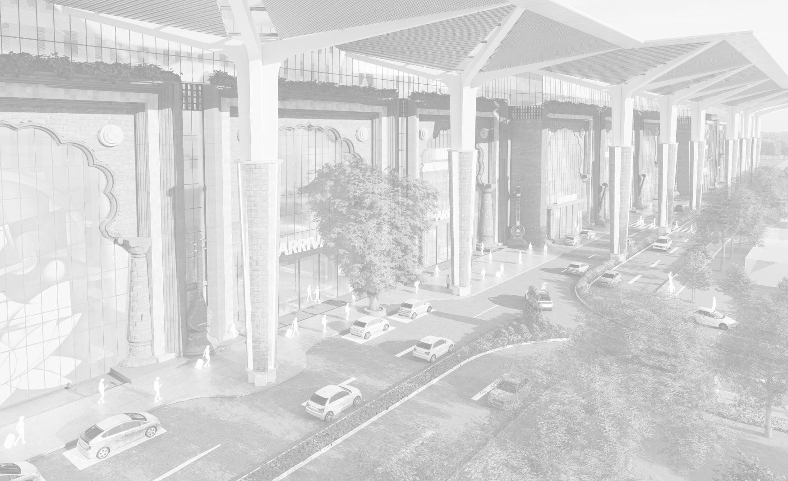


MIRAJ JUNCTION RAILWAY STATION

Slide 2
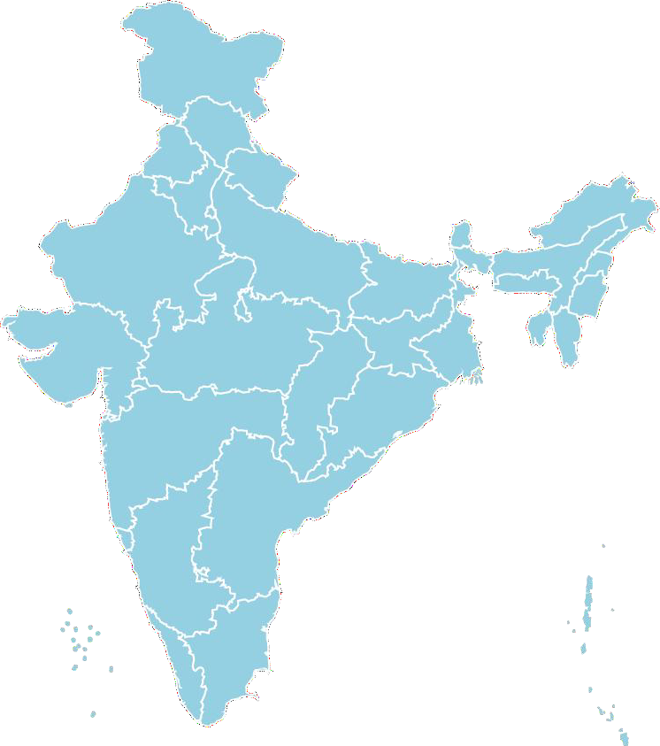
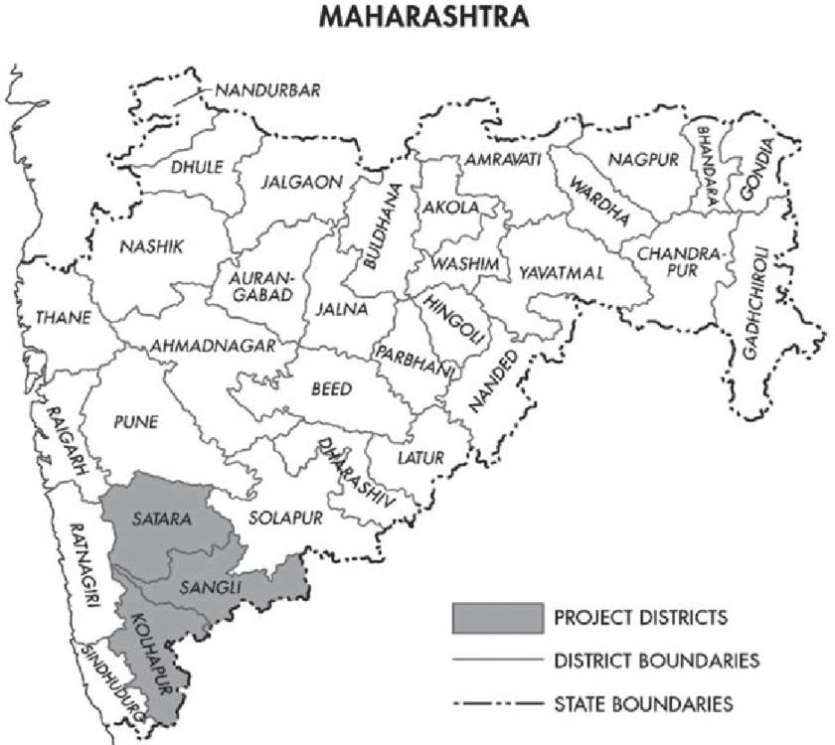
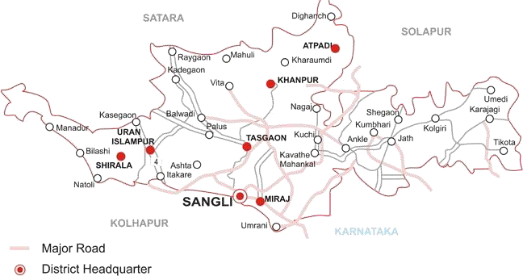
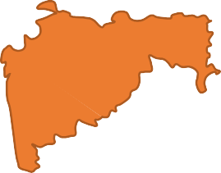


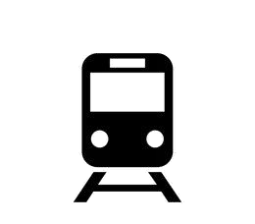







MIRAJ CITY
Miraj Railway Station
SITE LOCATION
MAHARASHTRA
SANGLI
CONNECTIVITY TO MIRAJ RAILWAY STATION
Airport Connectivity
Bus Connectivity
Tourist Places to Visit Near By
KOLHAPUR AIRPORT Airport
MIRAJ Bus Stand
Miraj MARKET
Ganesh Talav
Sangli Fort : 10 kms
Sagareshwar Wildlife Sanctuary : 56 kms
Audumbar Lord Datta Temple : 34 kms
Baliraja Agro Tourism
Distance - 52.7 kms
Distance - 500 m
Time -
1 Hr 20 minutes
Time -
3 minutes

Slide 3
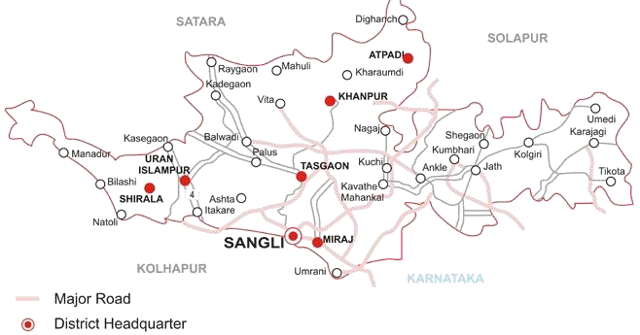
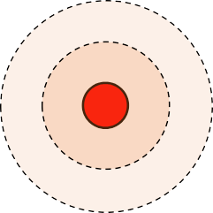
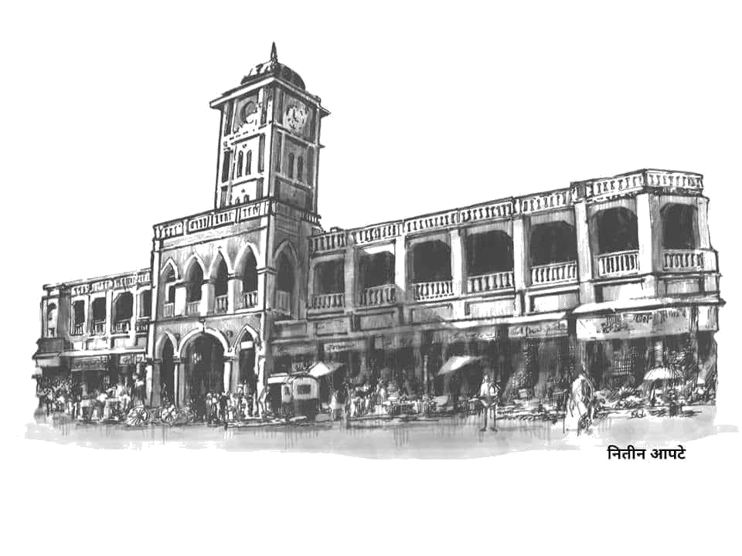
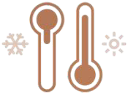






MIRAJ CITY DEMOGRAPHICS
ABOUT THE CITY
Miraj is a city in Sangli District, southern Maharashtra, India, that was founded in the early 10th century.
The city is recognised for Hindustani classical music and Medical services.
Many medical tourists visit from adjoining districts of North Karnataka and from Arab countries.
Miraj Railway Station
Sangli District
Climate
Maximum Temperature - 43 °C Minimum Temperature - 6.5 °C
680 mm of rainfall per year.
Humidity is: 82.0%
POPULATION
AREA
WIND SPEED
ELEVATION
LITERACY RATE
2021(Estimated)
4,36,217
118 km2
6 KM/hr
549 m
85.93%

Slide 4
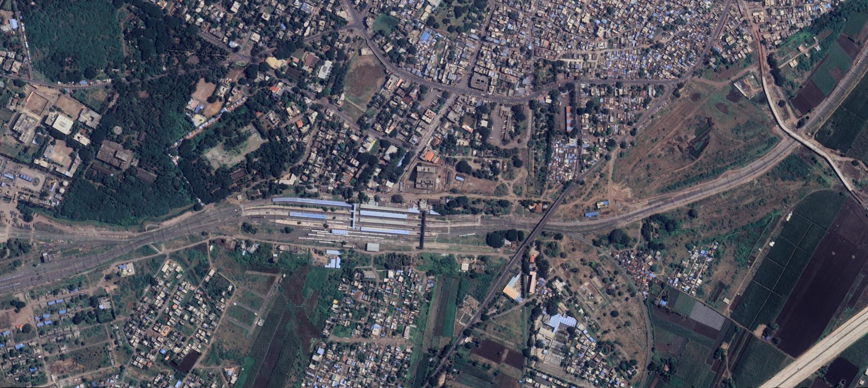
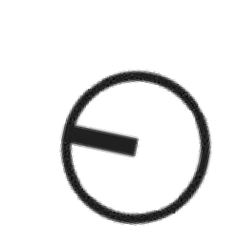
EXISTING MIRAJ JUNCTION RAILWAY STATION
KAVANTE
Kavanthe mahankal miraj road (SH-137)
Internal road
YASHWANTPUR
STATION RD
MIRAJ JUNCTION
PUNE
Maniknagar Bypass (3m wide)
Miraj road
KOLHAPUR
RAILWAY LINE
ROADS
MIRAJ BUS STAND
MIRAJ BUS DEPOT
N

Slide 5
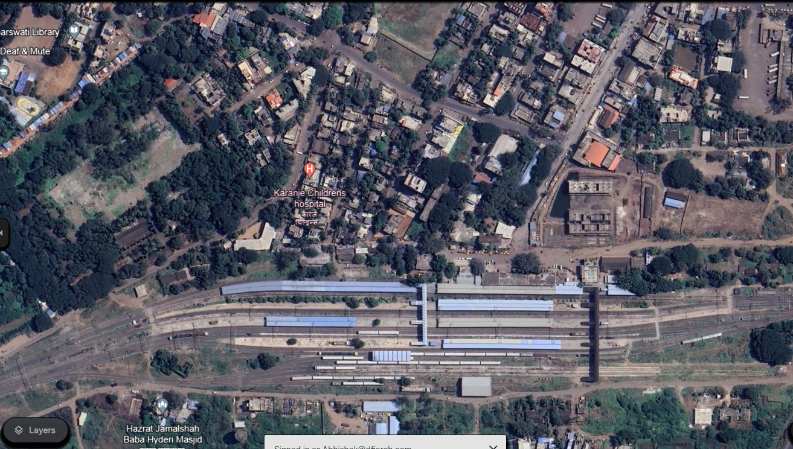
EXISTING MIRAJ JUNCTION RAILWAY STATION – ROAD CONNECTIVITY
INTERNAL ROAD
MIRAJ BUS STAND
STATION ROAD
INTERNAL ROAD-04
INTERNAL ROAD-03
INTERNAL ROAD-02
INTERNAL ROAD-01
MIRAJ JUNCTION
MANIKNAGAR BYPASS
MAIN ROAD/ INTERNAL ROADS
ENCROACHED /BLOCKED PART OF ROAD (NO VEHICLE ENTRY POSSIBLE)
N

Slide 6
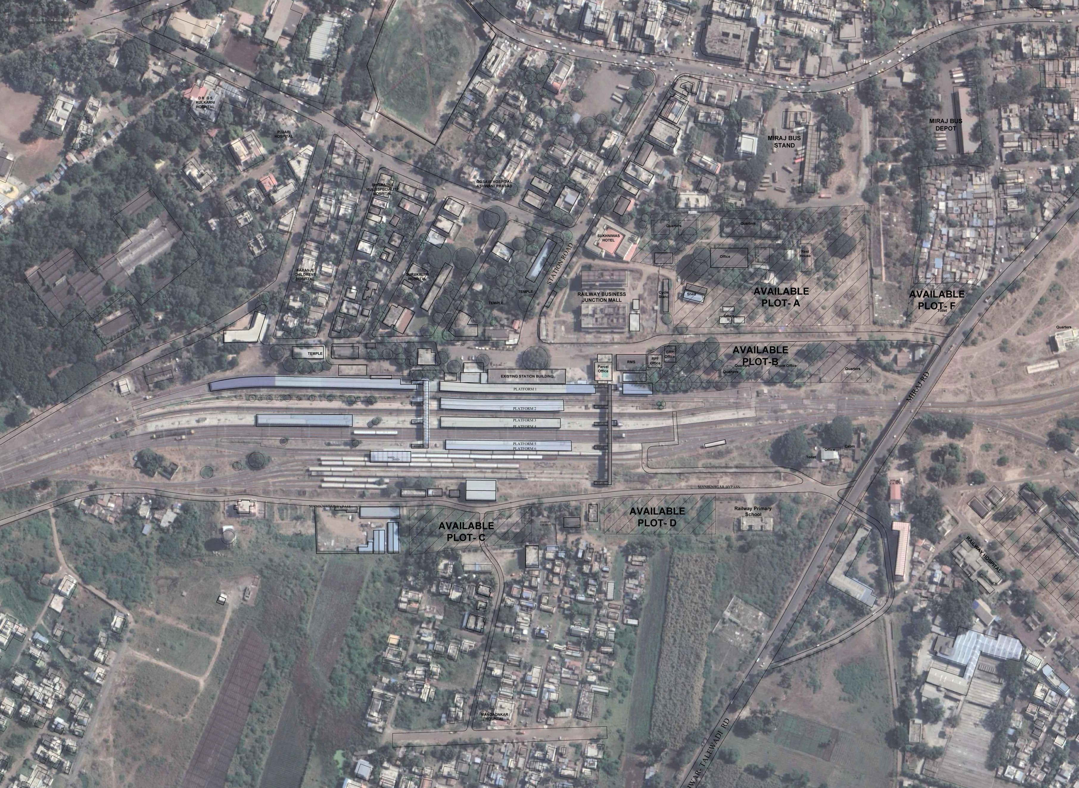




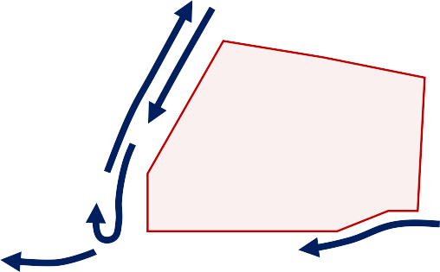
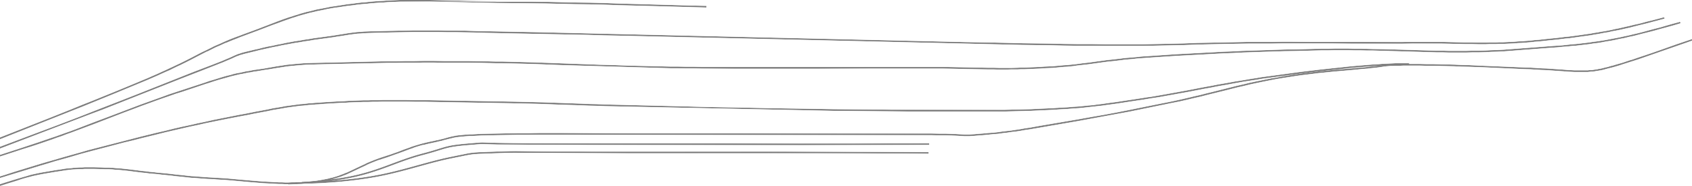

EXISTING CIRCULATION, PARKING AND INFRASTRUCTURE
KAVATHE MAHANKAL MIRAJ ROAD
MIRAJ BUS DEPOT
MIRAJ BUS STAND
STATION ROAD
UNDER CONSTRUCTION RAIL. BUSINESS JUNCTION MALL
AUTO PARKING
RAILWAY STATION
PLATFORM 1
KUNKESHWAR- TALEWADI ROAD
PLATFORM 2
PLATFORM 3
PLATFORM 4
PLATFORM 5
PLATFORM 6
FOB 2
FOB 1
ROB
MANIKNAGAR BYPASS
MIRAJ BUS STAND
BUS STAND CIRCULATION RAILWAY STATION CIRCULATION
ACCESSIBILITY
Railway station is accessed from east side only.
BUS STOP
PARKING
2 wheeler parking, 4 wheeler parking available at east side of station.
Miraj Bus stand is 500 m away from the railway station .
No bus stop along the rear side of the railway station.
N
FOB connects the East and West side.

Slide 7
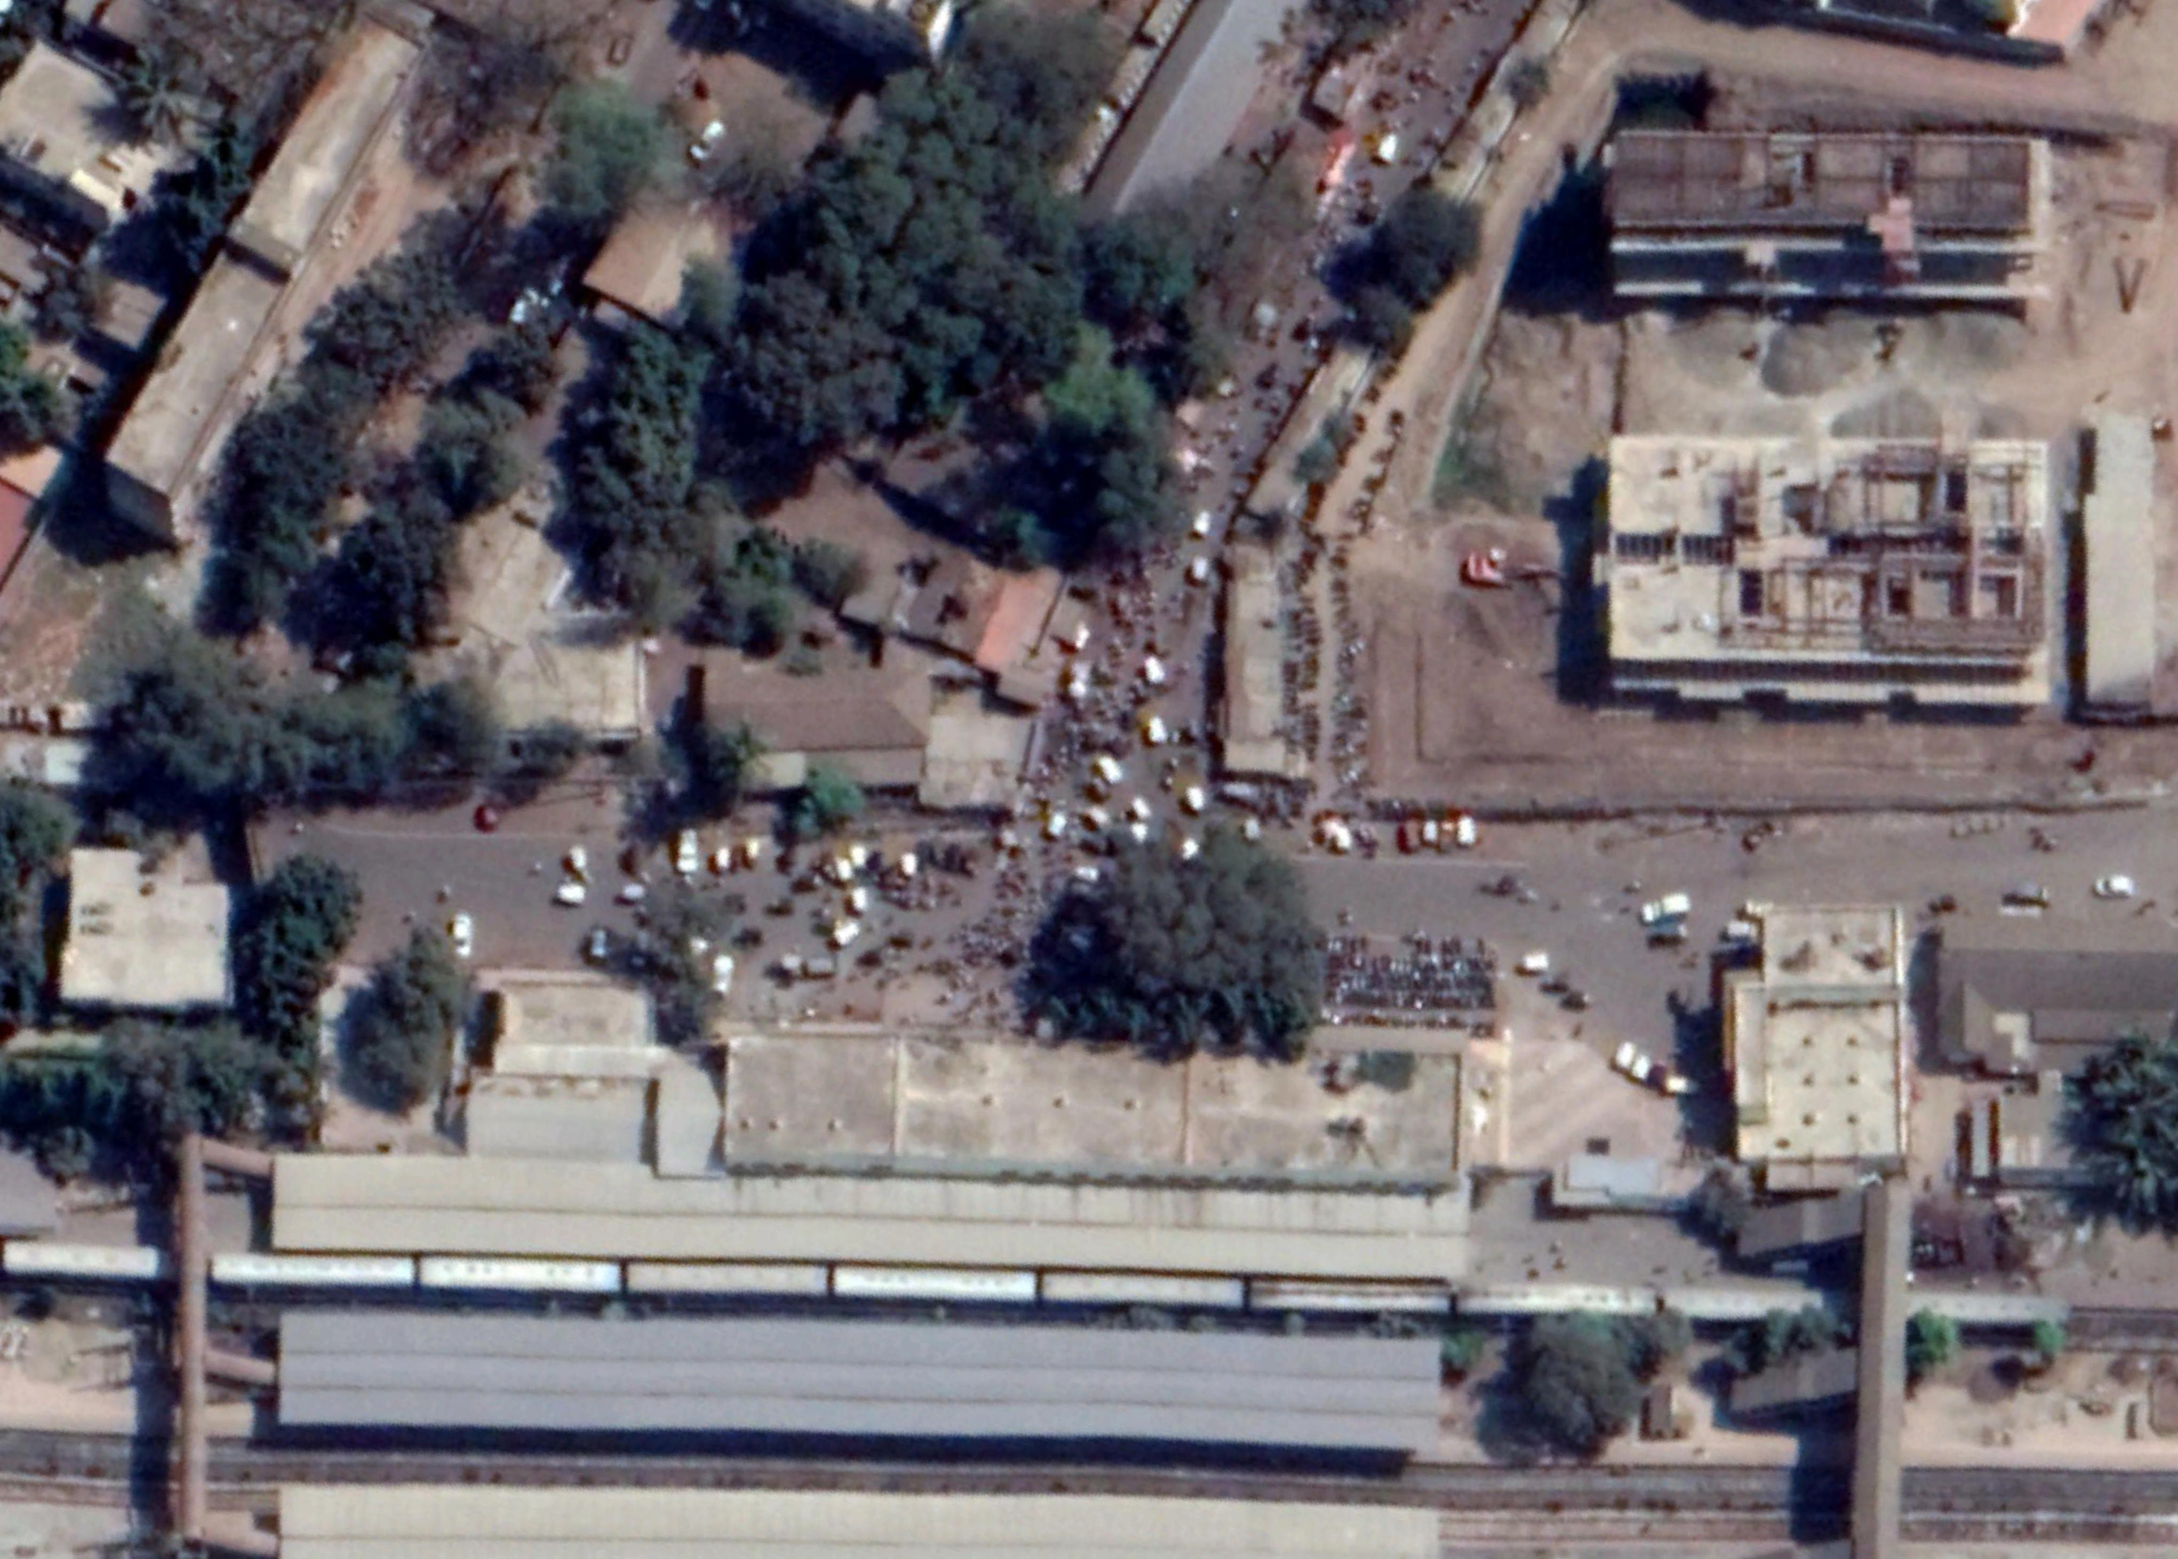
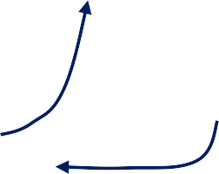


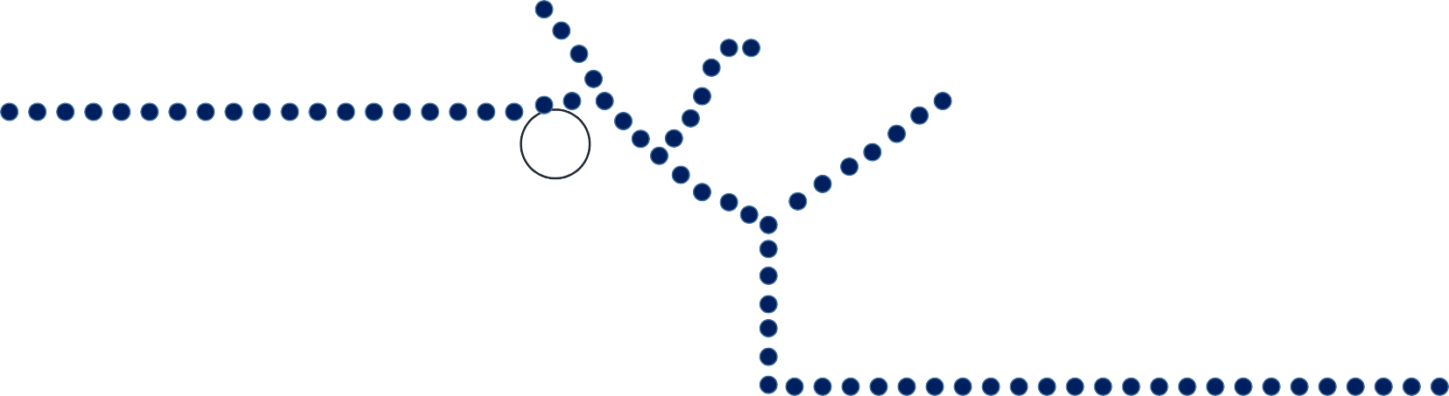



EXISTING CIRCULATION & PARKING
EXISITNG PARKING
AUTO PARKING - 30 TAXI PARKING - 15
2 WHEELER PARKING - 100
Segregation of lanes not done
Designated parking not provided
Drop off & Pick up lanes not defined
Departureand arrival not segregated
STATION ROAD
1
AREA OF CONGESTION
AUTO PARKING
2
TAXI PARKING
2 WHEELER PARKING
RMS OFFICE
3
PARCEL BUILDING DROP OFF
PARCEL OFFICE
RAILWAY STATION
4
FOB 2
FOB 1

Slide 8
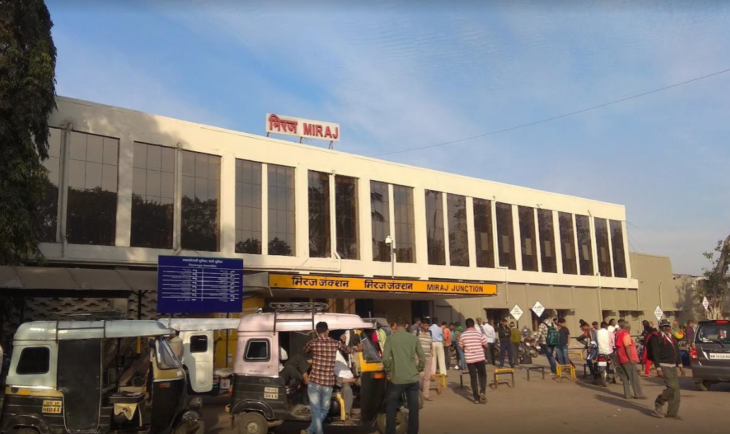
EXISTING MIRAJ RAILWAY STATION (ENTRANCE EAST SIDE)

Slide 9
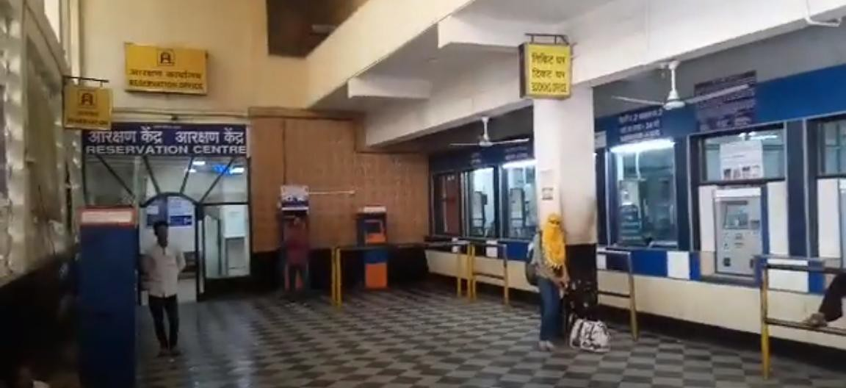
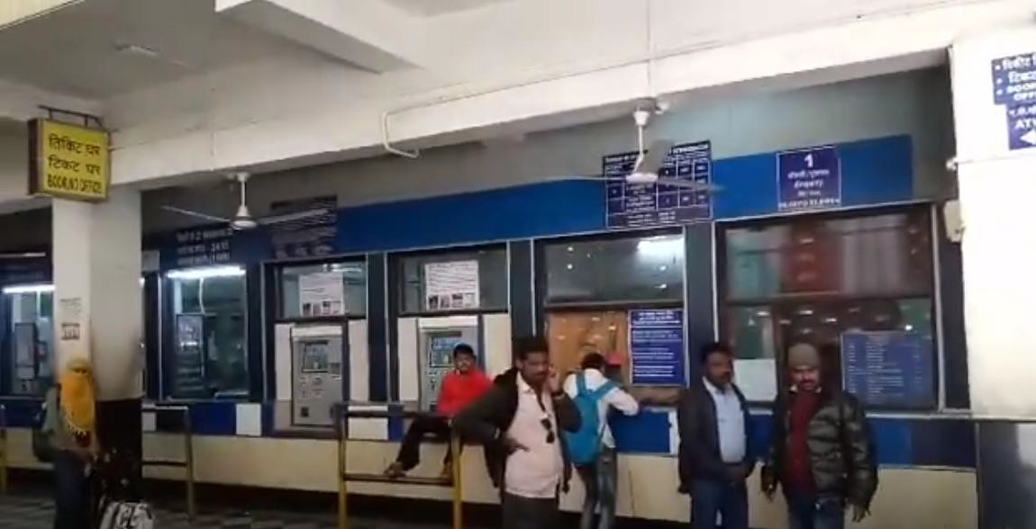
EXISTING MIRAJ RAILWAY STATION
RESERVATION CENTRE
TICKET COUNTER

Slide 10
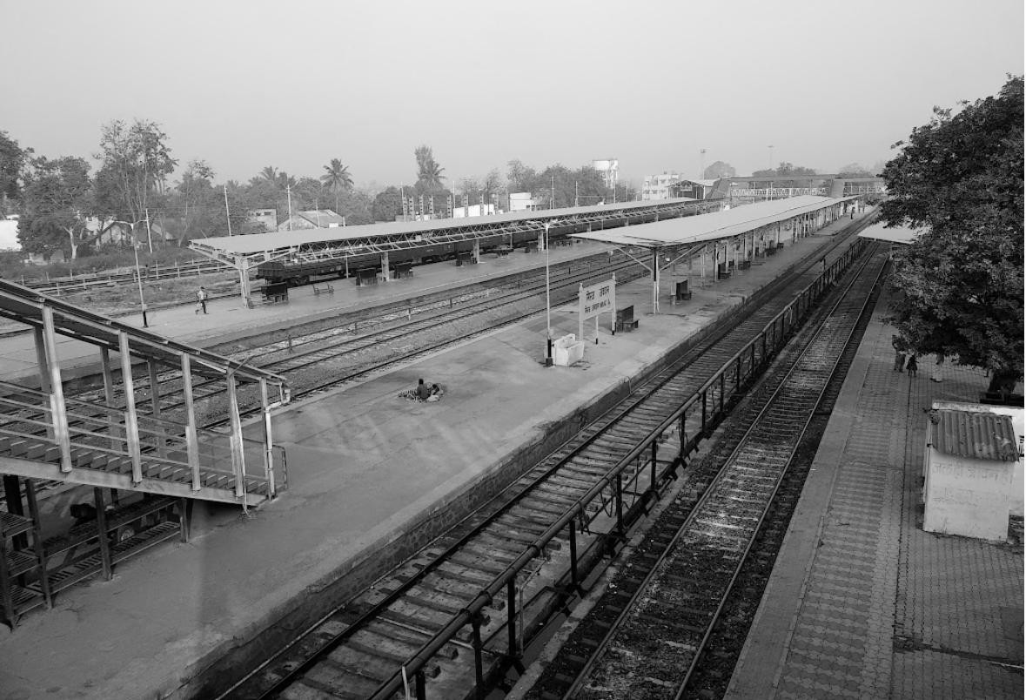
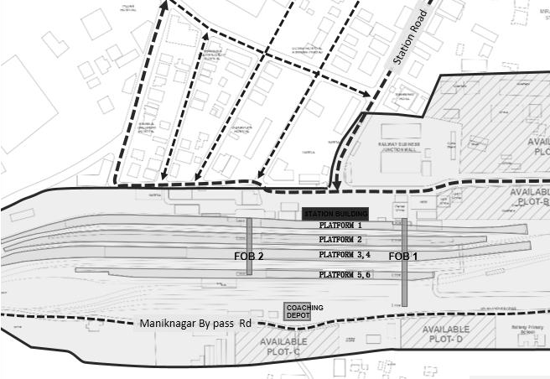
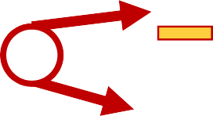
MIRAJ RAILWAY STATION : PLATFORMS
PLATFORM 6
10 M
PLATFORM 5
PLATFORM 4
14 M
PLATFORM 3
PLATFORM 2
3
KEY PLAN

Slide 11
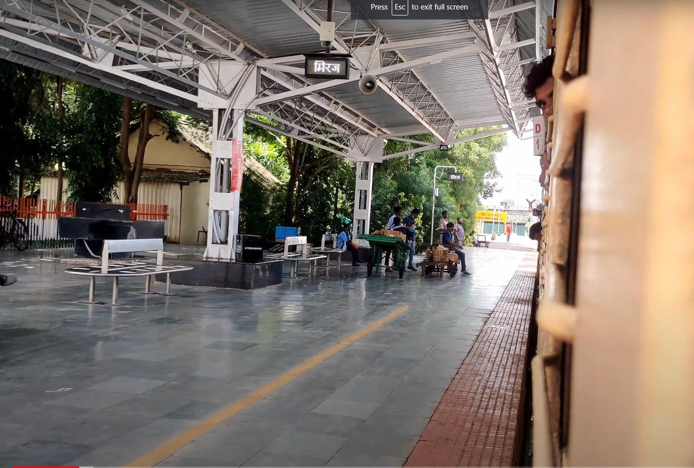
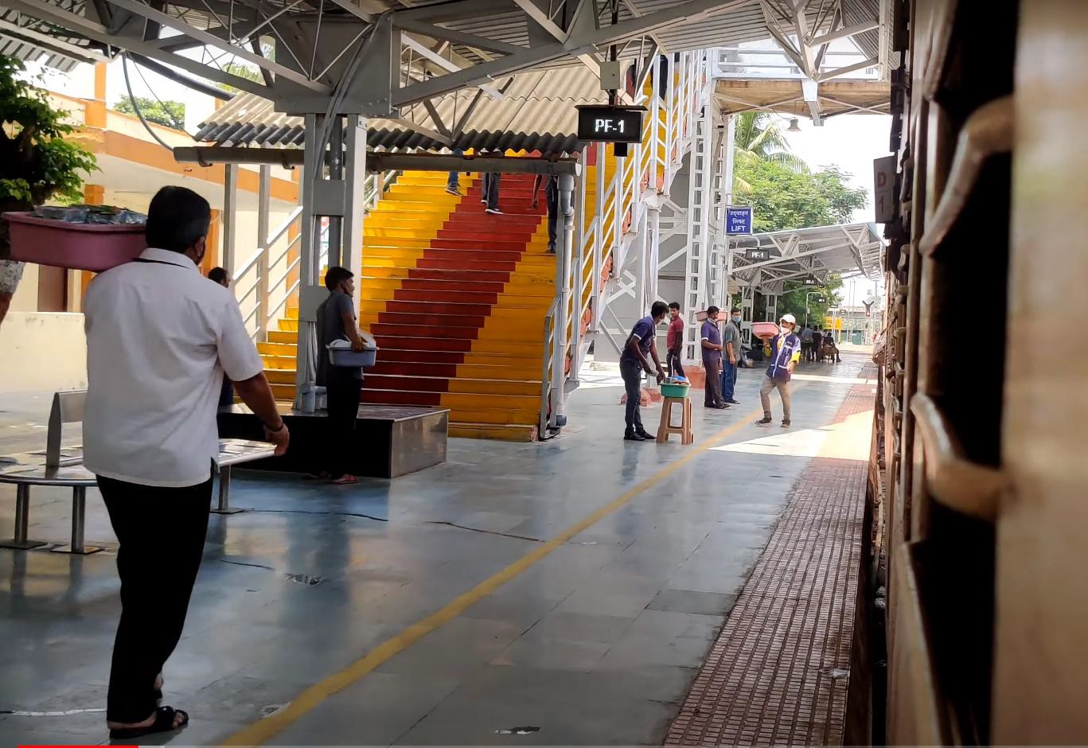
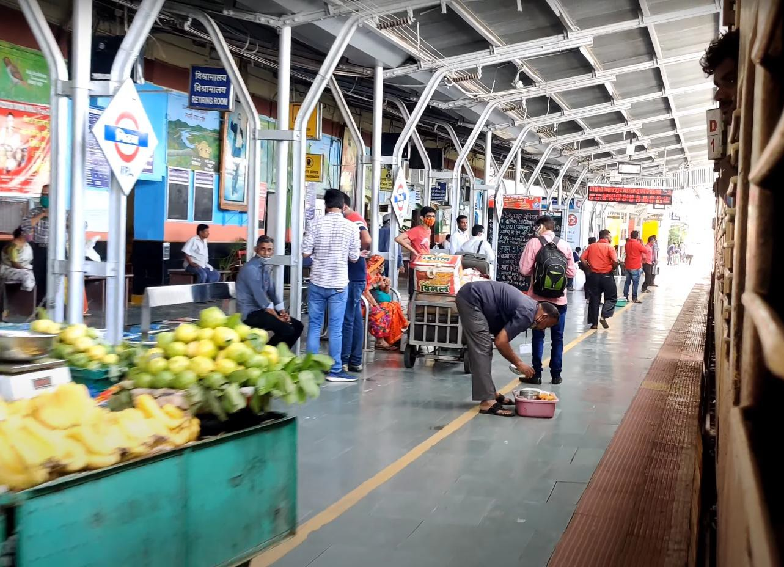
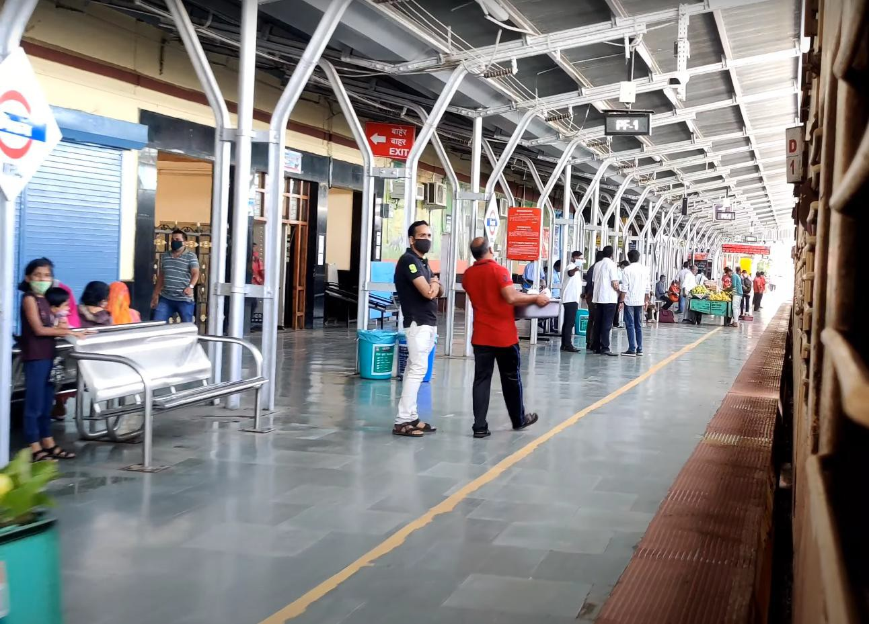
EXISTING STATION PLATFORM

Slide 12
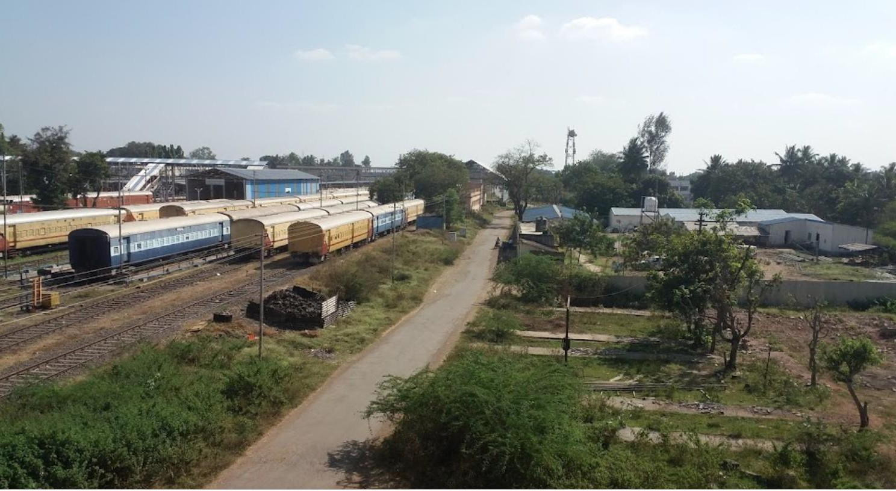
MIRAJ RAILWAY STATION : PLATFORMS
MIRAJ RAILWAY STATION : PLATFORMS
SINGLE LANE MANIKNAGAR BYPASS

Slide 13
KEY ISSUES WITH THE EXISTING STATION
NO CONTINUOUS TRAFFIC LOOP FOR VEHICLES. STATION ROAD ENDS AT STATION AND VEHICLES TAKE “U” TRUN FOR RETURN CAUSING CONGESSION.
NO DEDICATED PARKING FOR 2W/4W/AUTO OUTSIDE STATION.
NO STATION BUILDING ON WEST SIDE CAUSING LACK OF DEVELOPMENT THERE.
NO SEGRAGATION OF ARRIVING AND DEPARTING PASSENGERS.
ABSENCE OF LIFTS AND ELEVATORS FOR THE FOB.
INADEQUATE PUBLIC AMENITIES LIKE WAITING/SITTING AREAS AND TOILETS ETC.
THE ARCHITECTURAL RESPONSE TO BE COGNIZANT WITH THE ARCHITECTRUAL HERITAGE OF MIRAJ.

Slide 14
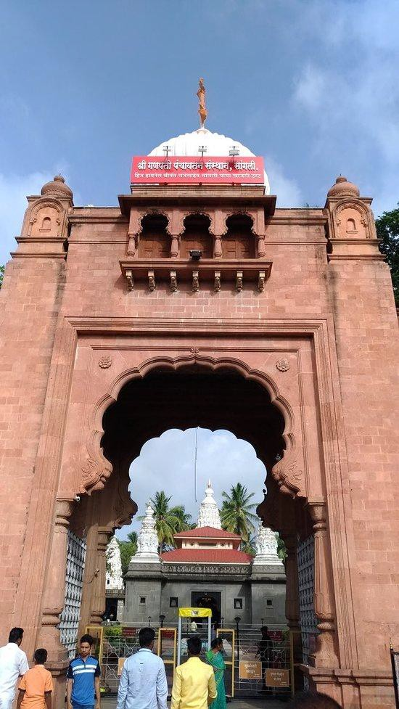
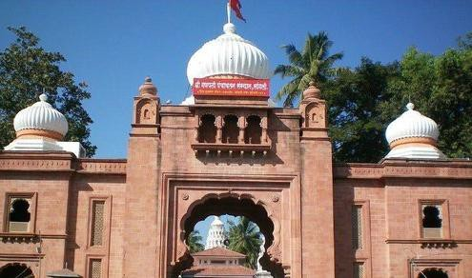
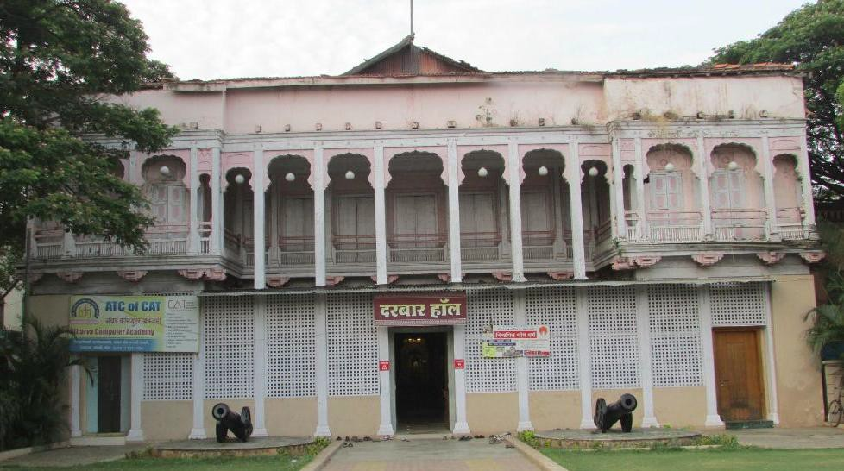
INSPIRED BY GANESH TEMPLE, NEAR MIRAJ
ARCHITECTURE OF PATWARDHAN PALACE

Slide 15
PASSENGER FOOTFALL
EXISTING DATA
2020-21 TOTAL ANNUAL FOOTFALL - 84,46,000
PROJECTED FOOTFALL FOR YEAR 2060
2060 TOTAL ANNUAL FOOTFALL – 1,25,74,000
PER DAY PASSENGER PEAK HOUR
- 23,140
- 2300 (approx)
PER DAY PASSENGER PEAK HOUR
- 34,448
- 3400 (approx)
14000000
12574000
12000000
11384000
10306000
10000000
9330000
8446000
8000000
6000000
4000000
2000000
0
2020
2030
2040
2050
2060
NOTES: 1% ANNUAL GROWTH IN PASSENGER FOOTFALL IS CONSIDERED FOR FUTURE FOOTFALL CALCULATION.

Slide 16
PASSENGER FOOTFALL
Yearly chart - Projected Passenger footfall
 | 2020 | 2030 | 2040 | 2050 | 2060
Peak Hour Passenger | 2300 | 2550 | 2820 | 3120 | 3400
sr.no. | Estimation of floor areas for station building/ Departure Concourse- MIRAJ RAILWAY STATION
1 | Horizon year | 2020 | 2030 | 2040 | 2050 | 2060 | Mela Surge @ 35%
2 | Passenger data | Area units ( SQ .M.)
2.1 | Average Annual day - Peak hour passenger demand (a) | 1160 | 1276 | 1404 | 1544 | 1698 | 2293
2.2 | Average Annual day - Peak hourDeparture passenger demand (b)** 55% of total peak hour passenger | 638 | 702 | 772 | 849 | 934 | 1261
2.3 | Average Annual day - Peak hourArrivalpassenger demand ©**45% of total peak hour Passenger | 522 | 574 | 632 | 695 | 764 | 1032
2.4 | Average annual day passenger demand per day (d) | 11600 | 12760 | 14036 | 15440 | 16984 | 22928
2.5 | Level of service envisaged | A | A | B | C | C | D
2.6 | Departure passenger - Waiting for more than 30 mins ** 40% of total peak hour passenger | 255 | 281 | 309 | 340 | 374 | 504

Slide 17
PASSENGER FOOTFALL
3 | Check in Queue Space for20%of total Peak hourDeparturepassengers (b) / Security Check
3.1 | Standard (sq.m./person) for check in queue space | 1.71 | 1.71 | 1.53 | 1.35 | 1.35 | 1.35
3.2 | Space Required (sq.m.) | 218 | 240 | 236 | 229 | 252 | 340
4 | Wait/circulate space for20%oftotal Peak hourDeparturepassengers
4.1 | Level of service envisaged | A | A | B | C | C | D
4.2 | Standard (sq.m./person) for wait/circulate space | 2.61 | 2.61 | 2.25 | 1.8 | 1.8 | 1.44
4.3 | CIRCULATION Space Required (sq.m.) | 333 | 366 | 347 | 306 | 336 | 363
5 | Waiting Area
5.1 | Level of service envisaged | A+ (3 SQ M) | A+ (3 SQ M) | A+ (3 SQ M) | A+ (3 SQ M) | A+ (3 SQ M) | B (2.25 SQ M)
5.2 | Wait area forExecutive class 5 % of peak passengers (e) | 38 | 42 | 46 | 51 | 56 | 142
5.3 | Level of service envisaged | A(2.61 SQ M) | A(2.61 SQ M) | A(2.61 SQ M) | A(2.61 SQ M) | A(2.61 SQ M) | B(2.25 SQ M)
5.4 | Wait area for 1st AC @ 10 % of peak passengers (f) | 67 | 73 | 81 | 89 | 98 | 132
5.5 | Level of service envisaged | B(2.25 SQ M) | B(2.25 SQ M) | B(2.25 SQ M) | B(2.25 SQ M) | B(2.25 SQ M) | C(1.8 SQ M)
5.6 | Wait area for2ND & 3RD AC @ 35 % of peak Departure passengers (g) | 201 | 221 | 243 | 267 | 294 | 318
5.7 | Level of service envisaged | C(1.8 SQ M) | C(1.8 SQ M) | C(1.8 SQ M) | C(1.8 SQ M) | C(1.8 SQ M) | D(1.44 SQ M)
5.8 | Wait area for SLEEPER & UNRESERVED 50 % of peak Departure passengers (h) | 230 | 253 | 278 | 306 | 336 | 363
5.9 | TOTAL AREA FOR WAITING (e+f+g+h) | 536 | 589 | 648 | 713 | 784 | 954

Slide 18
PASSENGER FOOTFALL
6 | Hold room for 30% of totalDeparturePeak hour passengers
6.1 | Standard (sq.m./person) for hold room space | 1.4 | 1.35 | 0.99 | 0.99 | 0.99 | 0.99
6.2 | Space Required (sq.m.) | 258 | 284 | 229 | 252 | 277 | 375
7 | Arrival lobbyfor10 % of totalArrivalPeak hour passengers
7.1 | Level of service envisaged | A | A | B | C | C | C
7.2 | Standard (sq.m./person) for lobby | 1.7 | 1.71 | 1.53 | 1.35 | 1.35 | 1.35
7.3 | Space Required (sq.m.) | 89 | 98 | 97 | 94 | 103 | 139
7.4 | Wait/circulate space for 20% oftotal Peak hourArrivalpassengers
7.5 | Level of service envisaged | A | A | B | C | C | C
7.6 | Standard (sq.m./person) for wait/circulate space | 2.61 | 2.61 | 2.25 | 1.8 | 1.8 | 1.8
7.7 | CIRCULATION Space Required (sq.m.) | 272 | 300 | 284 | 250 | 275 | 371
8 | Total Space required for check in queue + wait/circulate + Waiting areas | 1449 | 1593 | 1612 | 1592 | 1751 | 2169

Slide 19
3D VIEWS

Slide 20
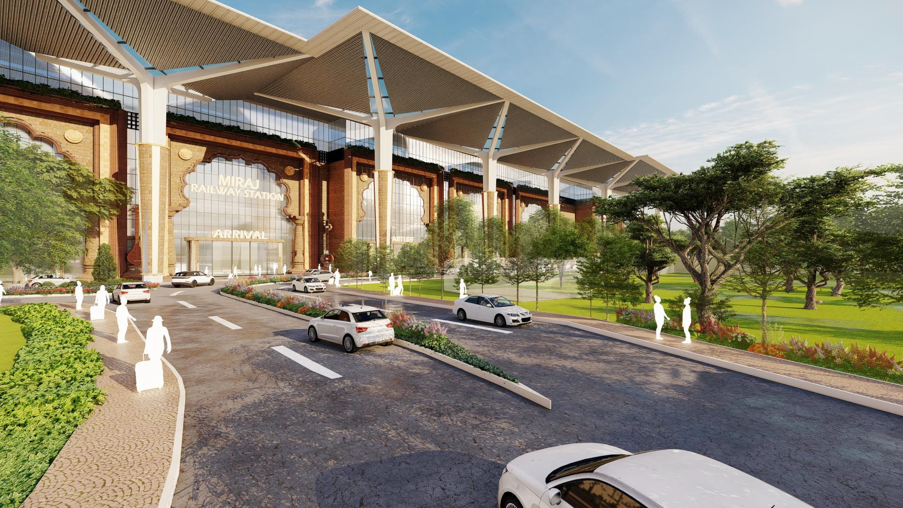
VIEW FROM STATION MAIN ENTRY (EAST SIDE)

Slide 21
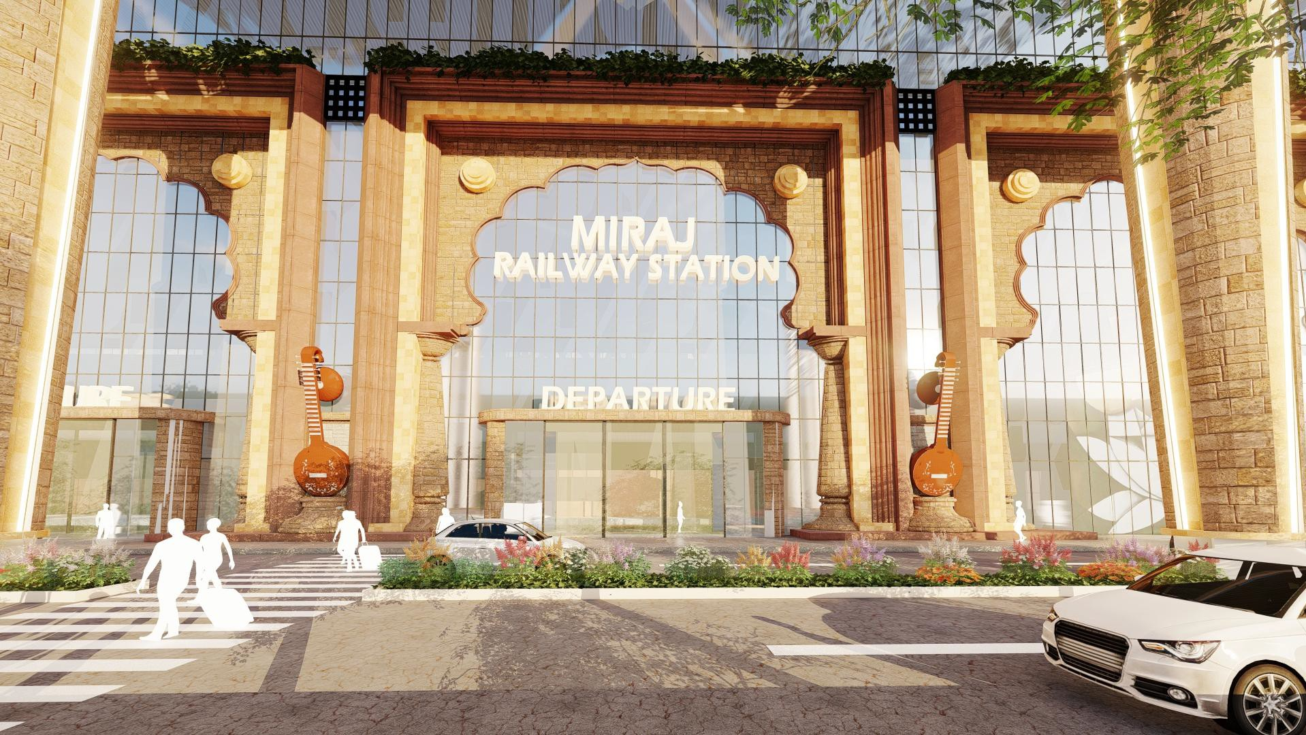
VIEW OF DEPARTURE GATE (EAST SIDE)
Miraj is known for historical and religious significance as well as cultural heritage.
It is also known for its rich tradition of classical music ,dance and theatre.

Slide 22
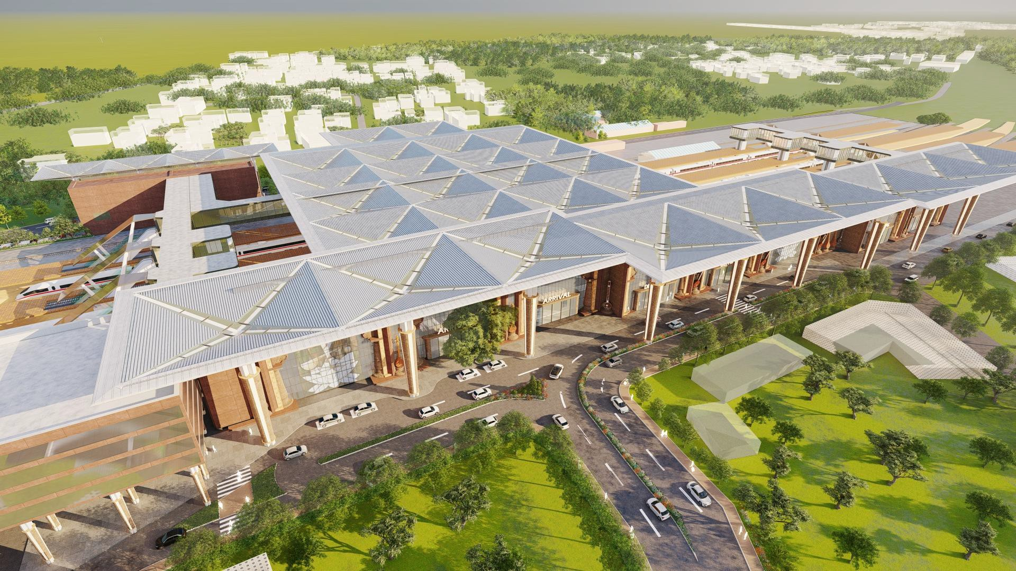
AERIAL VIEW OF STATION ENTRY

Slide 23
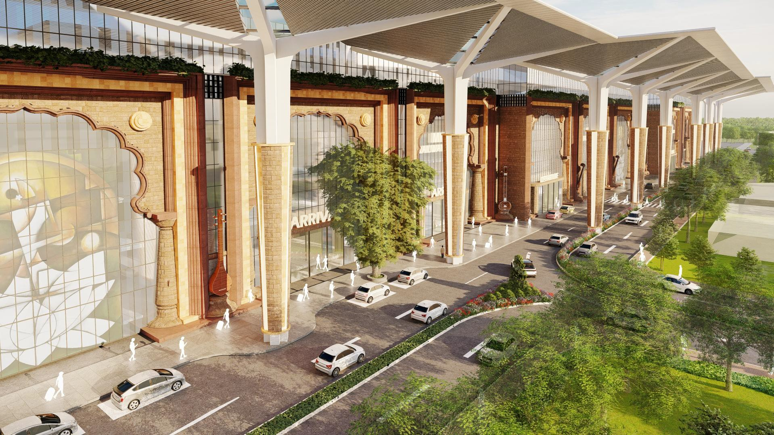
AERIAL VIEW OF STATION DROP-OFF AREA (EAST SIDE)

Slide 24
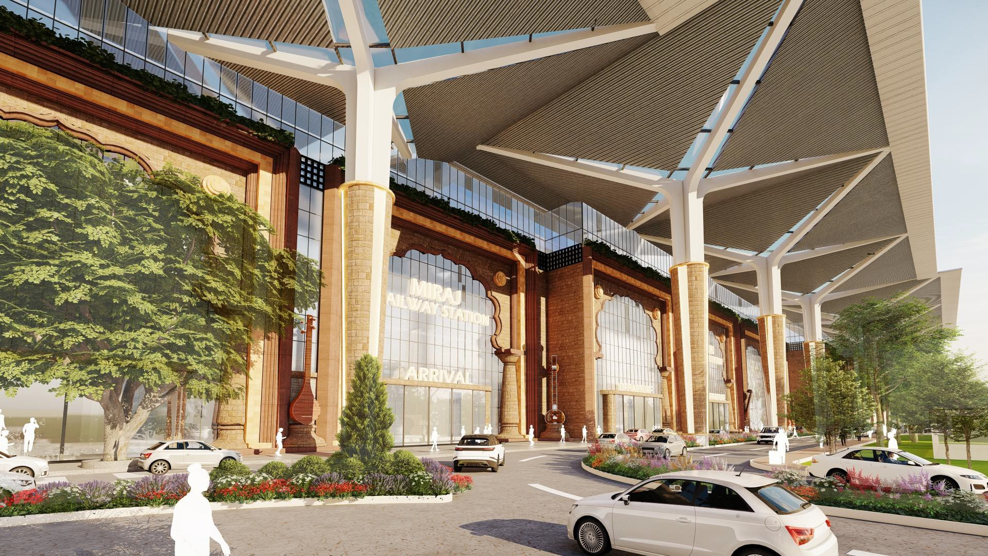
VIEW OF STATION FACADE (EAST SIDE)

Slide 25
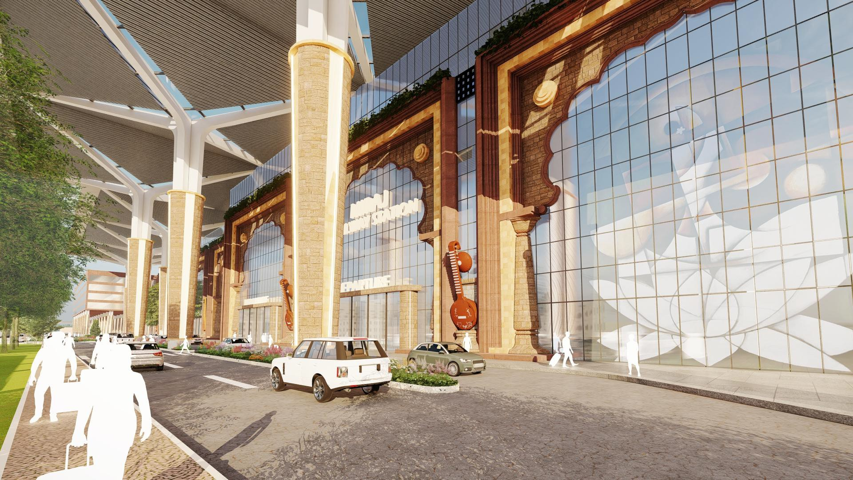
VIEW OF STATION FACADE (EAST SIDE)

Slide 26
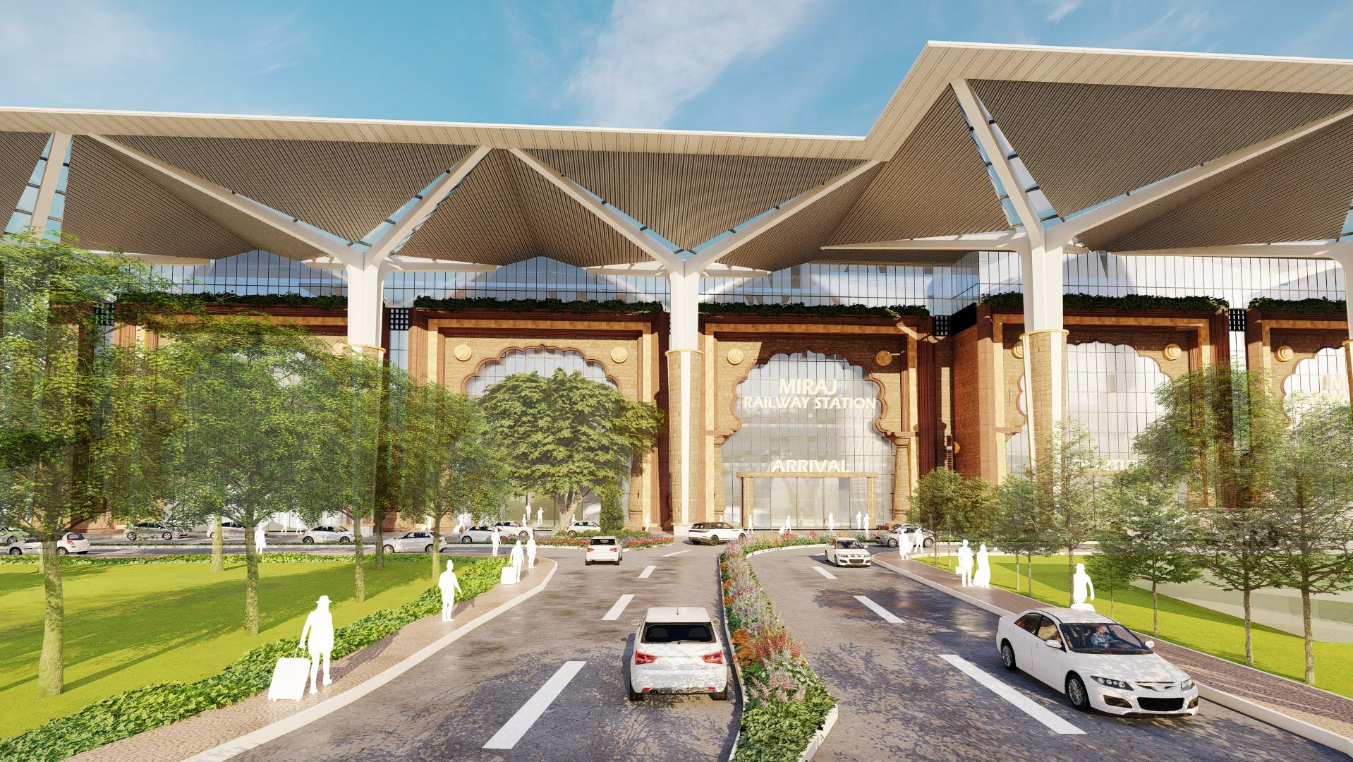
VIEW FROM MAIN ACCESS ROAD (EAST SIDE)

Slide 27
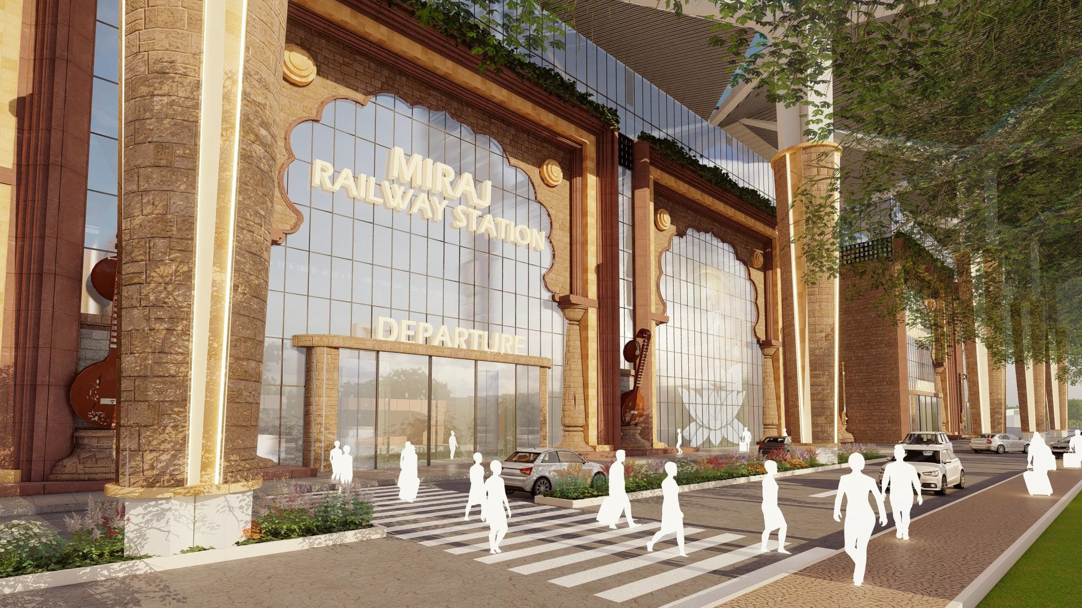
VIEW OF DEPARTURE GATE (EAST SIDE)

Slide 28
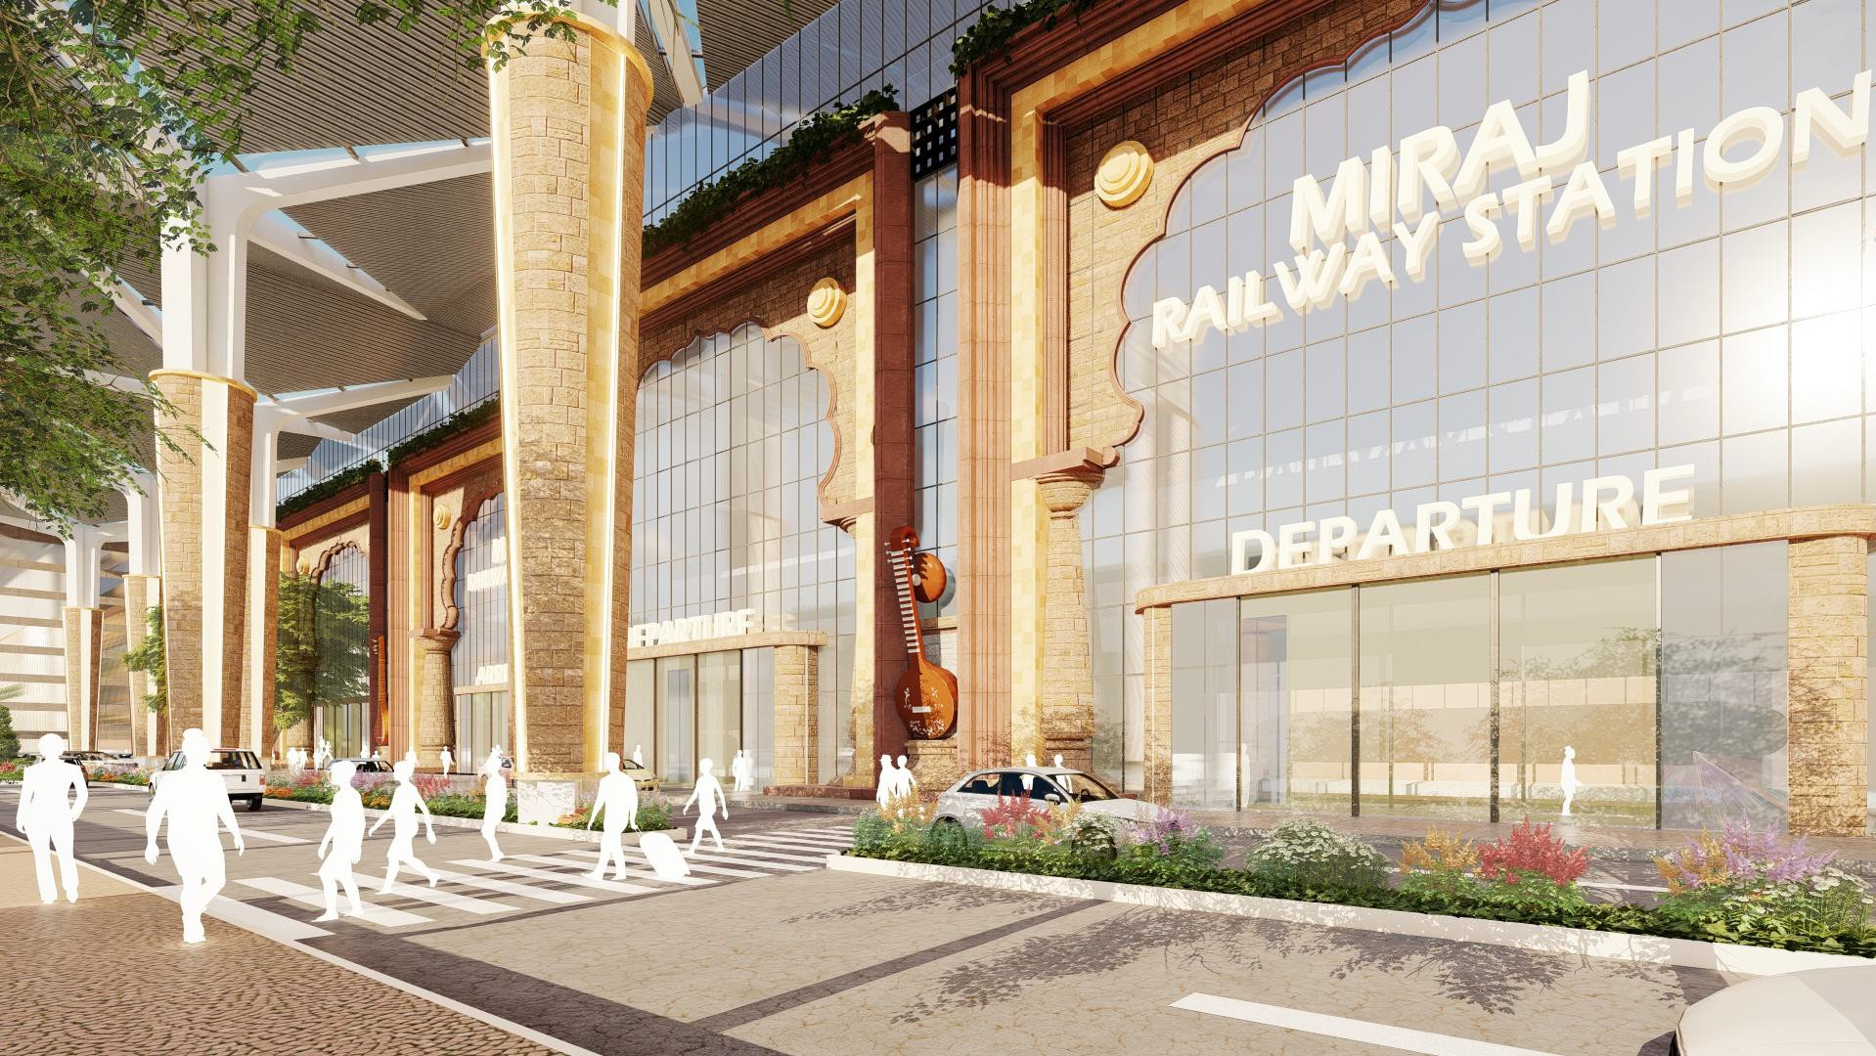
VIEW OF PEDESTRIAN CROSSING (EAST SIDE)

Slide 29
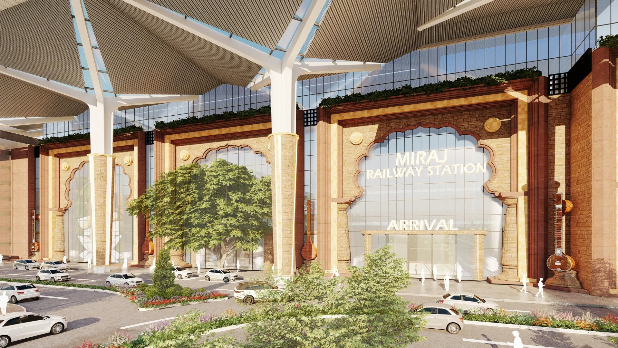
VIEW OF STATION ARRIVAL GATE (EAST SIDE)

Slide 30
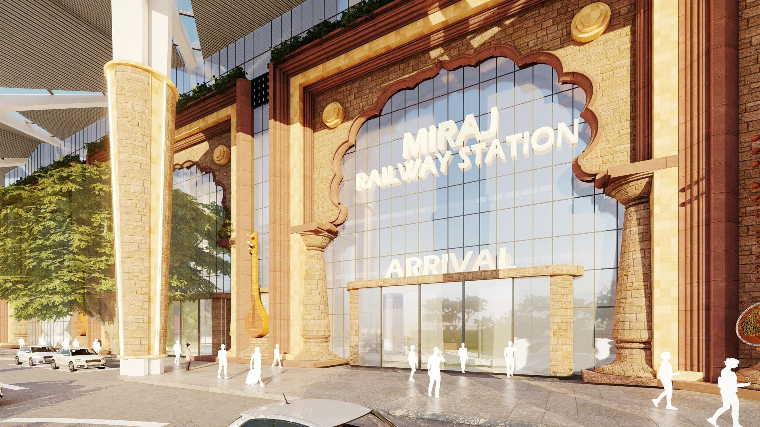
VIEW OF STATION ARRIVAL GATE (EAST SIDE)

Slide 31
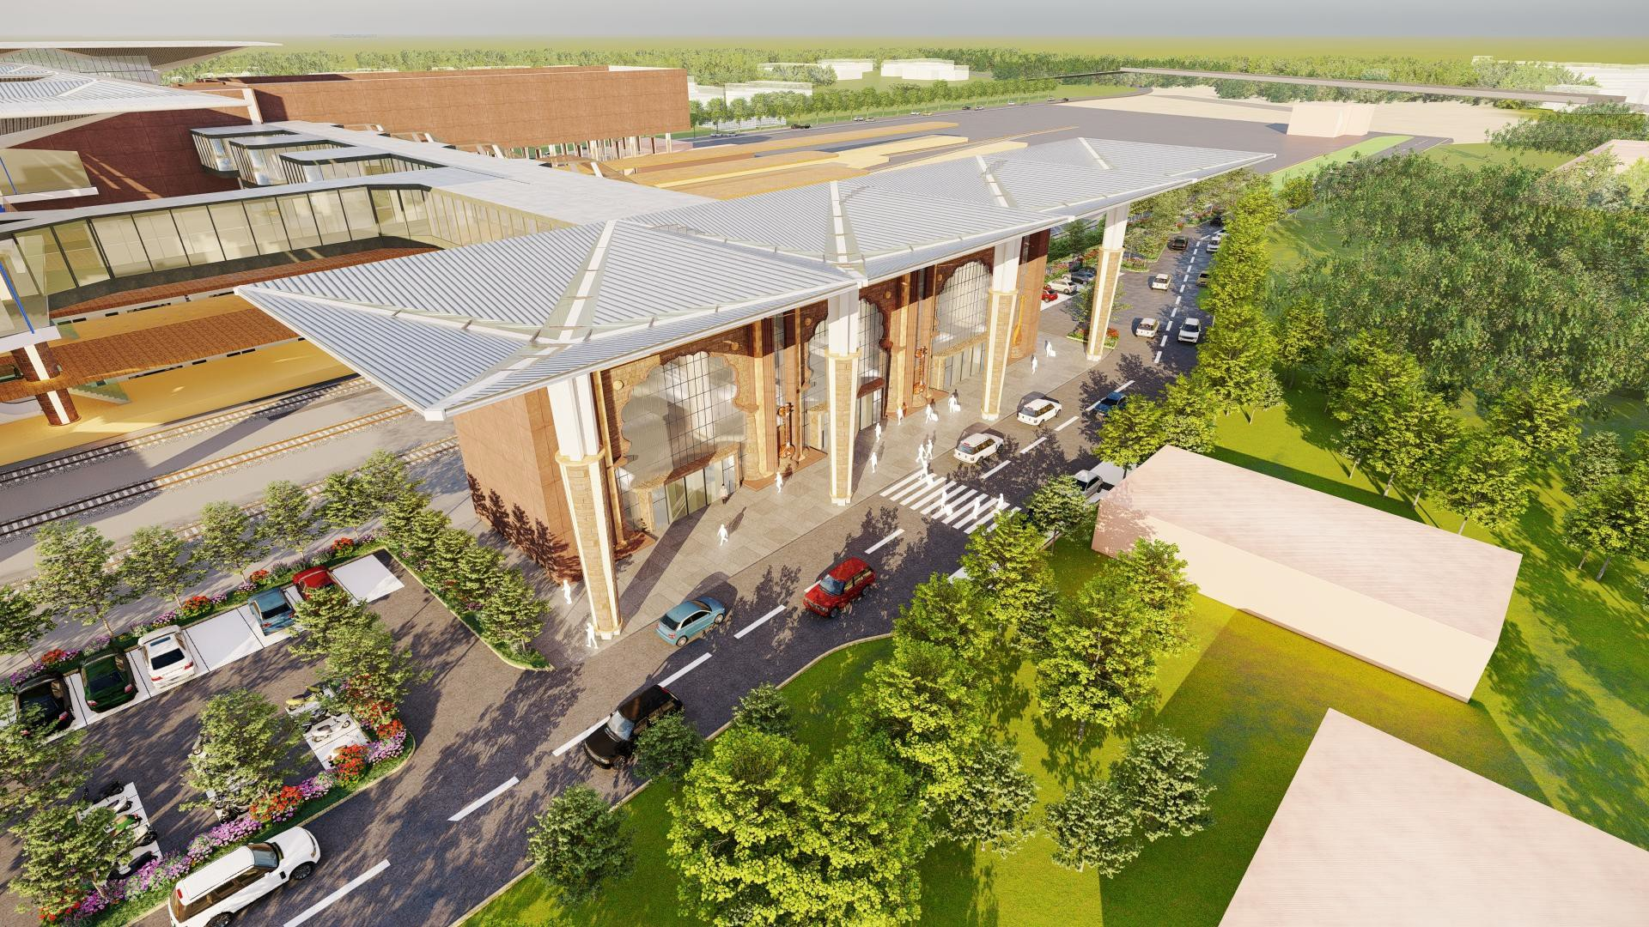
AERIAL VIEW FROM STATION (WEST SIDE)

Slide 32
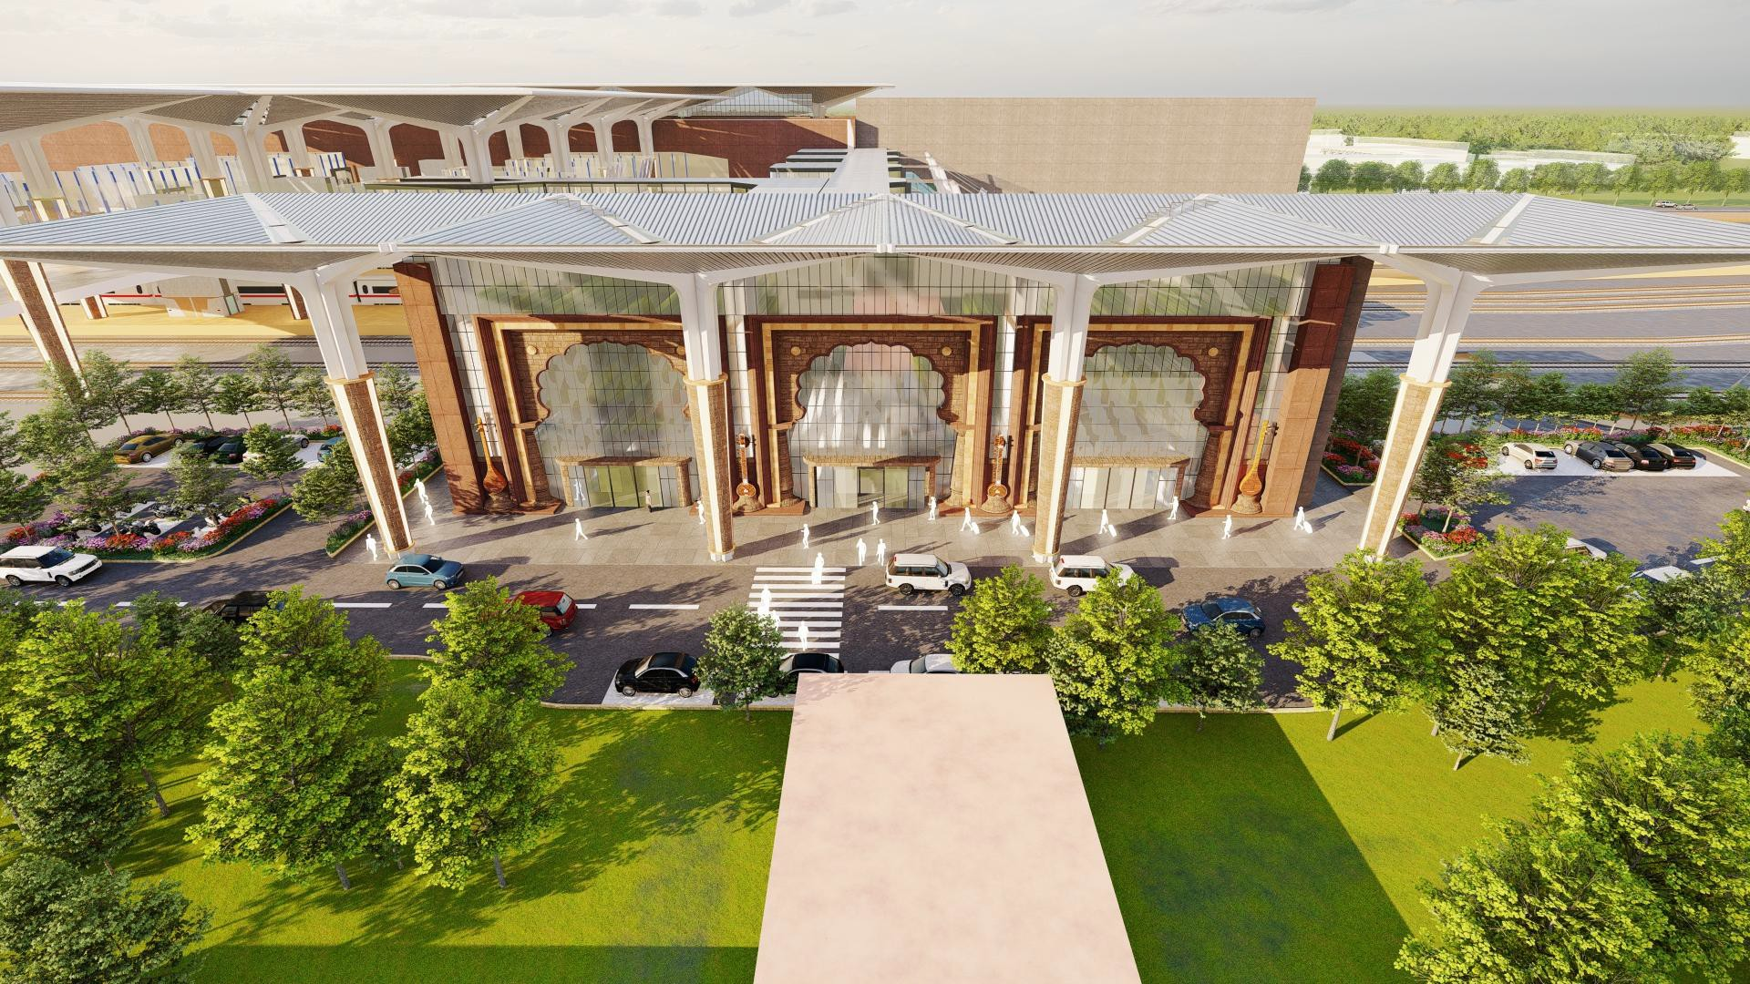
VIEW FROM STATION ENTRY (WEST SIDE)

Slide 33
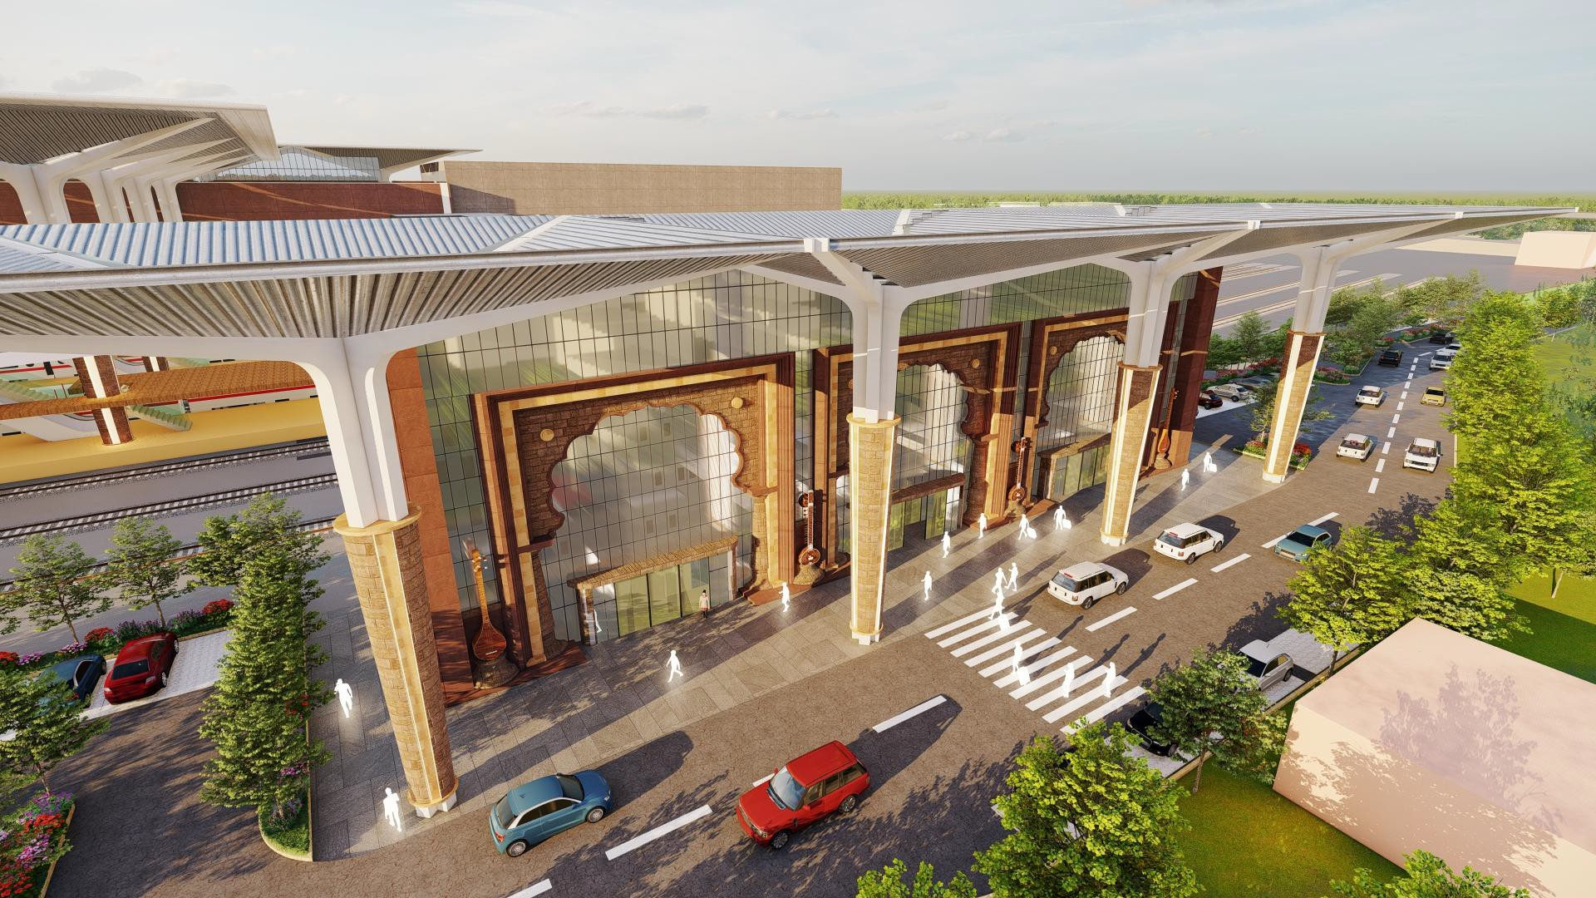
VIEW OF WEST SIDE STATION

Slide 34
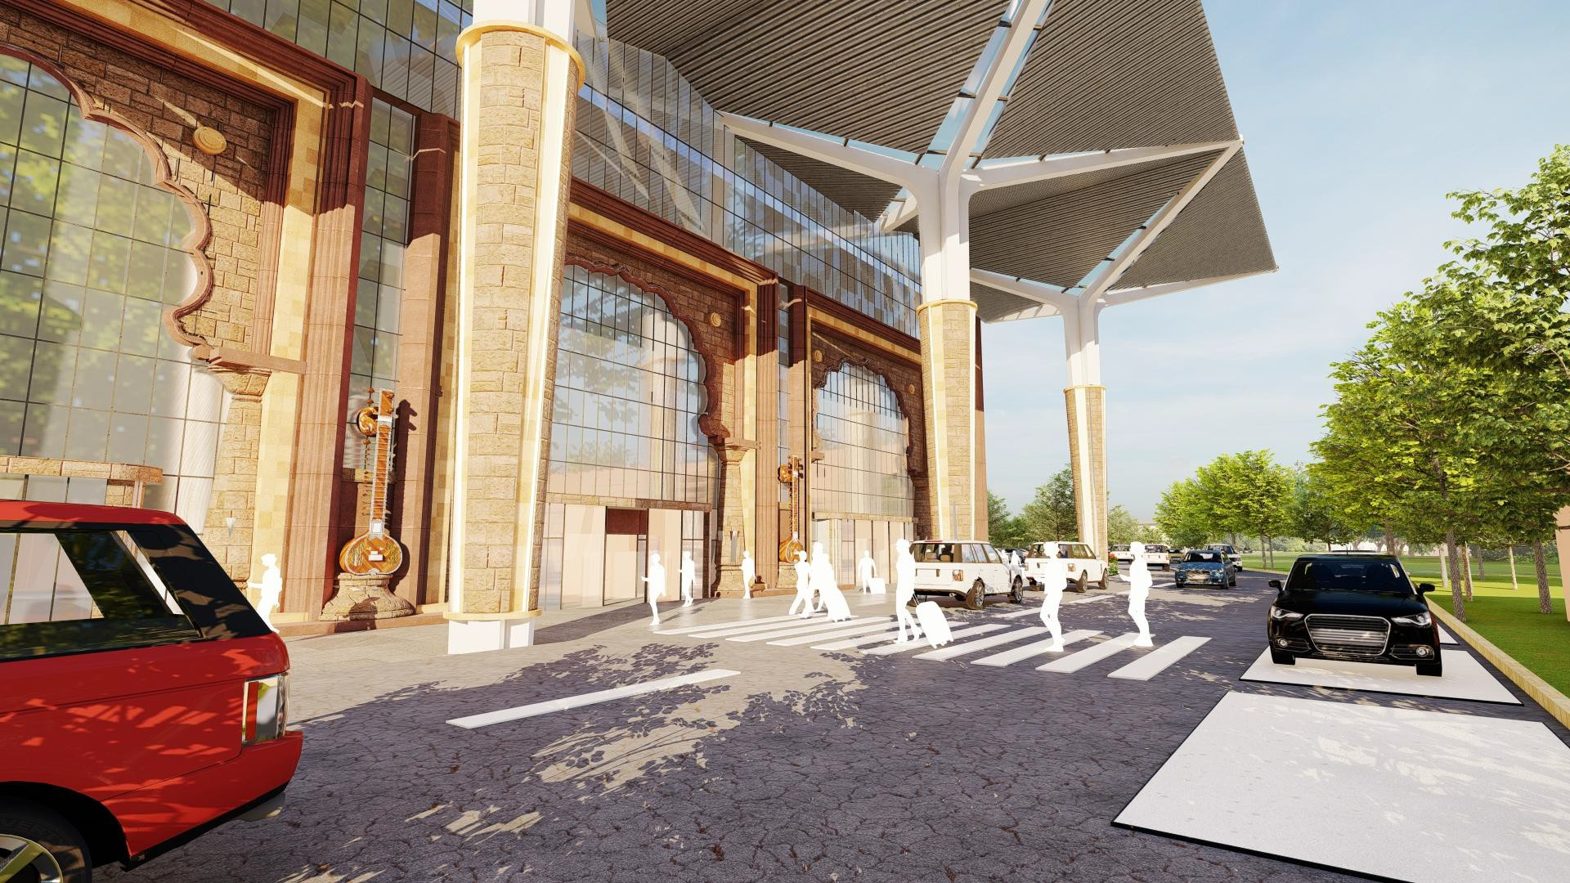
VIEW OF PEDESTRIAN CROSSING (WEST SIDE)

Slide 35
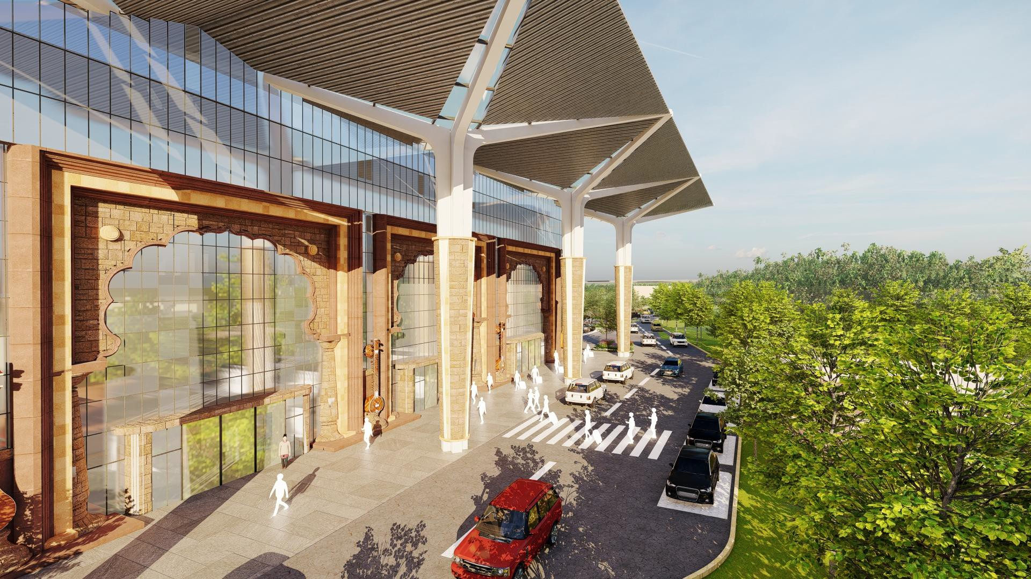
AERIAL VIEW OF STATION DROP-OFF AREA (WEST SIDE)

Slide 36
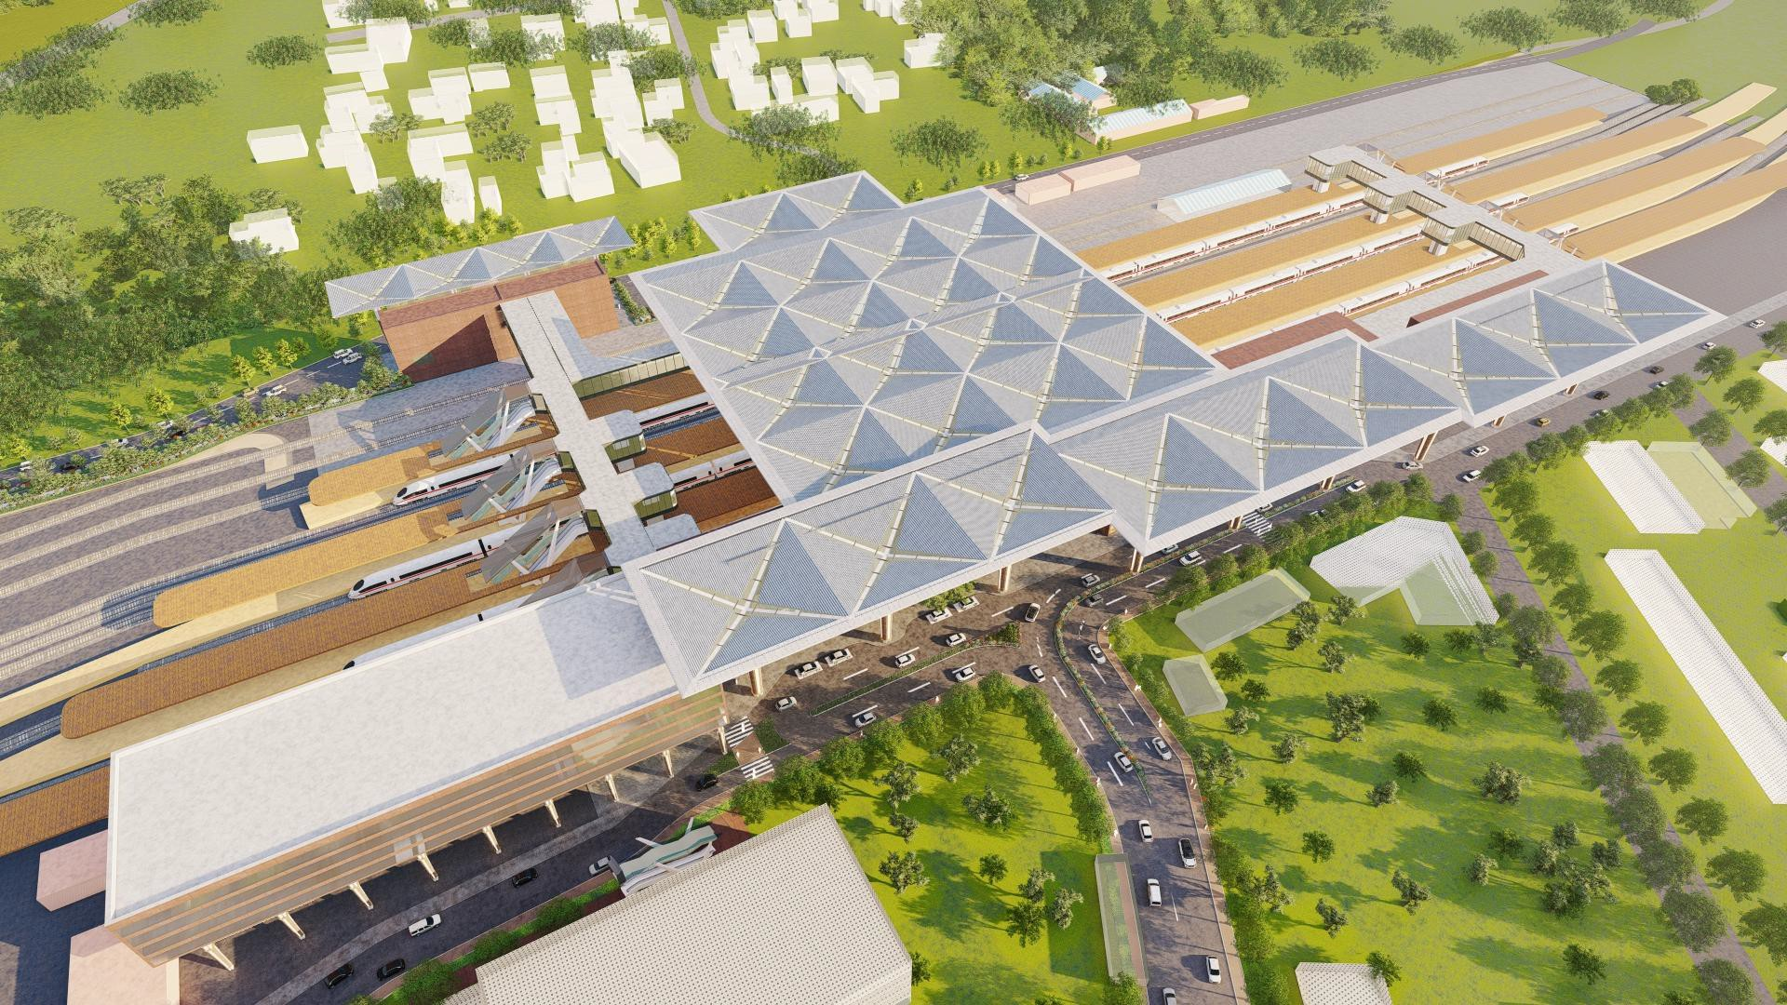
AERIAL VIEW OF STATION

Slide 37
MASTER PLAN

Slide 38


PROPOSED MASTER PLAN
105M
105M

Slide 39
FLOOR PLANS

Slide 40




GROUND LEVEL PLAN (PLATFORM LEVEL)
24 M

Slide 41

+5.5M LEVEL PLAN (INTERMEDIATE LEVEL)

Slide 42

+9 M LEVEL PLAN (CONCOURSE LEVEL)
24 M
24 M WIDE PASSAGE

Slide 43



DEPARTURE CONCOURSE LAYOUT
DN TO PLATFORM
DN TO PLATFORM
DN TO PLATFORM
DN TO PLATFORM
80M
24 M WIDE CONCOURSE
DN TO PLATFORM
DN TO PLATFORM
24M
DN TO PLATFORM
DN TO PLATFORM

Slide 44




STATION LAYOUT PLAN OF EAST SIDE
ARRIVAL BLOCK-1
ARRIVAL BLOCK-1
DEPARTURE BLOCK
ARRIVAL BLOCK-2
Station Layout At Platform Level
Station Layout At +5.5m Level
Station Layout At +9m Level
KEY PLAN

Slide 45
STATION LAYOUT PLAN OF WEST SIDE
Station Layout At Platform Level
Station Layout At +5.5m Level
Station Layout At +9m Level
KEY PLAN

Slide 46
AREA STATEMENT
SN | Items | No of floors | Area in Sqm (East + West) | Size (length x Width) |  | Remarks
1 | Area of Development (Station building + Concourse + Connecting bridges ) | G+2 | 17165
 |  |  | East Side Terminal 9775 | 238M x 21 M Arrival block 1– 85M x13M Arrival block 2-65M x22M Departure Block 1- 90M x 18M
 |  |  | West Side Terminal 1800 | 60M x 10M
2 | Station Building | Platform level | 3975
 |  | At +5.5 Level | 3315
 |  | At +9 Level | 4300
3 | Air concourse | Departure Concourse (24M Wide) At +9 Level | 1850
 |  | 2 No. Arrival Bridges (6M Wide) At +9 Level | 3000
 |  | Connecting Bridges At +9 Level | 725
4 | Roof,covering and platform areas | Station Main Roof | 7000
 |  | Connecting Bridge coverings (Arrival air concourse+ departure connecting bridge) | 2900
 |  | Platform covering | 14000
 |  | Platform Refurbishment | 22000
5 | Surface parking | East Side terminal- 100 (2W), 25 (auto) and 20(4W) | 1580(EAST SIDE) 1000 (WEST SIDE)
 |  | West Side terminal- 20 (4W), 40 (2W) and 20 (auto)
6 | No of platforms | 6
7 | Escalators | 23 (+9M LVL) 01(+5.5 M LVL)
8 | Lift | 23
9 | FOBS | Proposed 2 No. Arrival Bridges (6M Wide) At +9 Level and 1 existing | 250 (extension), 500 (renovation)
10 | MLCP | NA

Slide 47
ESTIMATE
PROPOSED MANDATORY AREAS- NORTH SIDE
REDEVELOPMENT OF MIRAJ JUNCTION RAILWAY STATION
ABSTRACT OF COST ESTIMATE
SL No | PACKAGES | Area (sqm) | TOTAL AMOUNT (INR) | Rate/ Sq.m
 | RAILWAY INFRASTRUCTURE DEVELOPMENT
1 | STATION BUILDING
 | MAIN BUILDING (East Side + West Side) | 11590 | 69,54,00,000 | 60,000
2
 | MAIN ROOF
3 | Aluminium Double seem standing roof with Insulation - Roofing system | 7,000 | 24,50,00,000 | 35,000
4 | DEPARTURE CONCOURSE BLOCK | 1850 | 13,32,00,000 | 72,000
5 | ARRIVAL CONCOURSE & CONNECTING BRIDGE BLOCK | 3725 | 24,58,50,000 | 66,000
6 | EXISTING PLATEFORMS DEVELOPMENT
 | ROOFING & FLOORING | 36,000 | 28,80,00,000 | 8,000
7 | CONNECTING BRIDGE COVERING COST | 3725 | 5,58,75,000 | 15,000
8 | RAILWAY OFFICE BUILDING (G+2)+ ORH | 1,884 | 9,42,08,000 | 50,000
9 | EXTERNAL DEVELOPMENT |  | 10,00,00,000
10 | LIFT & ESCALATORS |  | 25,00,00,000
11 | INTERNAL & EXTERNAL SIGNAGES (INCLUDING ROAD DIRECTIONS OVER ELEAVTED ROAD & DIGITAL SIGNANGES AT ALL APPROPRIATE LOCATIONS) |  | 1,50,00,000
12 | ART WORK (Lumpsum ) |  | 5,00,00,000
13 | STREET FURNITURE INCLUDING FURNITURE FOR DEPARTURE CONCOURSE , RAILWAY OFFICES ETC |  | 1,00,00,000
14 | MEP High Side |  | 15,00,00,000
15 | PROVISIONAL COST OF UTILITY SHIFTING |  | 5,00,00,000
 | Golf Cart 2Nos |  | 16,00,000
 | High Mast 20M High 2Nos |  | 50,00,000
 | TOTAL FOR STATION DEVELOPMENT (GST inclusive) |  | 238,91,33,000
A | D & G Charges @ 5.32% |  | 12,71,07,875
1 | Add : Contengies @ 1% |  | 2,38,91,330
 | Add : Design Charge @ 1% |  | 2,38,91,330
 | Total Cost (A) |  | 256,40,23,535
B | DEMOLITION OF PART STATION BUILDING, BRIDGE RAILWAY QUARTERS (Amount to be credited ) 1 Cr Lumsum |  | 1,00,00,000
 | Miscellaneous
 | G.TOTAL (A-B) |  | 257,40,23,535
 | AMOUNT IN CR. |  | 257.4

Slide 48
RELOCATION STAGES

Slide 49

RELOCATION STAGE - 1
NEW CONSTRUCTED STRUCTURE DEMOLISHED STRUCTURE EXISTING STATION BUILDING
U/C
REST
HOUSE
EXISTING STATION BUILDING
STAGE-1
Office building and staff house will be demolished and temp provision will be made in existing station building at first floor.

Slide 50
RELOCATION STAGE - 2
NEW CONSTRUCTED STRUCTURE DEMOLISHED STRUCTURE EXISTING STATION BUILDING
Arrival Hall -01
EXISTING STATION BUILDING
6M WIDE ARRIVAL FOB
STAGE-3
Part of the existing station building to be demolished in this stage and facilities there to be shifted to arrival hall-01 at intermediate level.
b. For remaining facilities, temporary arrangement to be done on rent.
West side station building

Slide 51


RELOCATION STAGE - 3
NEW CONSTRUCTED STRUCTURE DEMOLISHED STRUCTURE EXISTING STATION BUILDING
Arrival Hall -01
Departure Hall
PART EXISTING STATION BUILDING
24M WIDE DEPARTURE CONCOURSE
6M WIDE ARRIVAL FOB
6M WIDE CONNECTING BRIDGE
STAGE-4
Departure hall, Departure concourse and connecting bridge to the west side station building to be constructed in this stage.
West side station building

Slide 52
RELOCATION STAGE - 4
NEW CONSTRUCTED STRUCTURE DEMOLISHED STRUCTURE EXISTING STATION BUILDING
Arrival Hall -01
Departure Hall
PART EXISTING STATION BUILDING
24M WIDE DEPARTURE CONCOURSE
6M WIDE ARRIVAL FOB
6M WIDE CONNECTING BRIDGE
STAGE-5
Remaining part of existing station building to be demolished in this stage and facilities there to be shifted to newly constructed departure hall at platform level and intermediate level.
West side station building

Slide 53
RELOCATION STAGE - 5
NEW CONSTRUCTED STRUCTURE DEMOLISHED STRUCTURE EXISTING STATION BUILDING
Arrival Hall -01
Departure Hall
Arrival Hall -02
24M WIDE DEPARTURE CONCOURSE
6M WIDE ARRIVAL FOB-01
6M WIDE ARRIVAL FOB-02
STAGE-6
Arrival hall-02 and FOB-02 to be constructed in this stage.
West side station building

Slide 54
3D VIEWS
OPTION-2

Slide 55

VIEW OF STATION DROP-OFF AREA

Slide 56

VIEW OF STATION ENTRY

Slide 57

AERIAL VIEW OF STATION ENTRY

Slide 58

VIEW OF CONCOURSE

Slide 59

VIEW OF CONCOURSE

Slide 60

3D VIEW
AERIAL VIEW OF STATION

Slide 61
3D VIEWS
OPTION-03 (COLONNADE THEME)
.

Slide 62

VIEW-01

Slide 63

VIEW-02

Slide 64

VIEW-03

Slide 65

VIEW-04

Slide 66

VIEW-05

Slide 67

VIEW-06

Slide 68
THANK YOU

Slide 69
EXTRACT OF FACTS
DIRECTION: EAST(MAIN) & West
TOTAL BUILTUP AREA: 17165 sq.m.(E+W)
(Terminal buildings + Air concourse
+Connecting bridge)
SURFACE PARKING (E+W) : 50(4W) +150(2W) + 50 (Auto rickshaw)
DEPARTURE CONCOURSE: 24MX80M (600 SEATING CAPACITY)
ARRIVAL CONCOURSE WIDTH: 6M
TOTAL COST: 257 CR
PASSENGER DEMAND (PEAK) 2300 (2020) 3400 (2060)
LOS ENVISAGED A(2020-40) B(2040-50) C(2050-60)

